Slide 1
PYTHON
Prepared by : MOUNIKA

Slide 2


Introduction
Python is a popular programming language.
It was created by Guido van Rossum, and released in 1991.

Slide 3
What can Python do?
Python can be used on a server to create web applications.
Python can be used alongside software to create workflows.
Python can connect to database systems. It can also read and modify files.
Python can be used to handle big data and perform complex mathematics.
Why Python?
Python works on different platforms (Windows, Mac, Linux, Raspberry Pi, etc).
Python has a simple syntax similar to the English language.
Python has syntax that allows developers to write programs with fewer lines than some other programming languages.
Python runs on an interpreter system, meaning that code can be executed as soon as it is written. This means that prototyping can be very quick.
Python can be treated in a procedural way, an object-oriented way or a functional way.

Slide 4
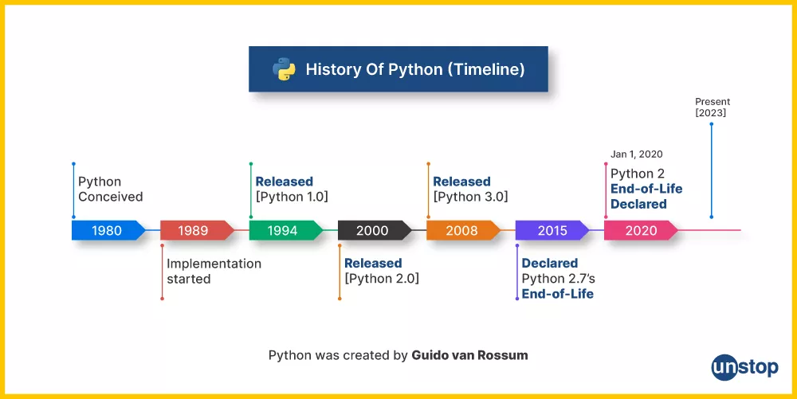
History of python:

Slide 5
Mr.Guido Van Rossum(Netherland)
1989(centrum wiskunde and informatica(CWI))→ABC language develop
(during christmas)
The inspiration for the name came from the BBC’s TV Show – ‘Monty Python’s Flying Circus’, as he was a big fan of the TV show and also he wanted a short, unique and slightly mysterious name for his invention and hence he named it Python!

Slide 6
where we use python?
Data Science
Desktop Applications
Console-based Applications
Mobile Applications
Software Development
Artificial Intelligence
Web Applications
Enterprise Application
3D CAD Applications
Machine Learning
Computer Vision or Image Processing Applications
Speech Recognition
Scientific computing
Education
Testing
Gaming
IoT
Networking
Finance
Audio and Music
Writing scripts

Slide 7
Applications:
GUI based desktop applications
Graphic design, image processing applications, Games, and Scientific/ computational Applications
Web frameworks and applications
Enterprise and Business applications
Operating Systems
Education
Database Access
Language Development
Prototyping
Software Development

Slide 8
Advantages:
Open source and community development
Versatile, Easy to read, learn and write
User-friendly data structures
High-level language
Dynamically typed language(No need to mention data type based on the value assigned, it takes data type)
Object-oriented language
Portable and Interactive
(IoT)Internet of Things Opportunities
Interpreted Language
Portable across Operating systems

Slide 9
Organization using python:
Google(Components of Google spider and Search Engine)
Yahoo(Maps)
YouTube
Mozilla
Dropbox
Microsoft
Cisco
Spotify
Quora

Slide 10


Slide 11
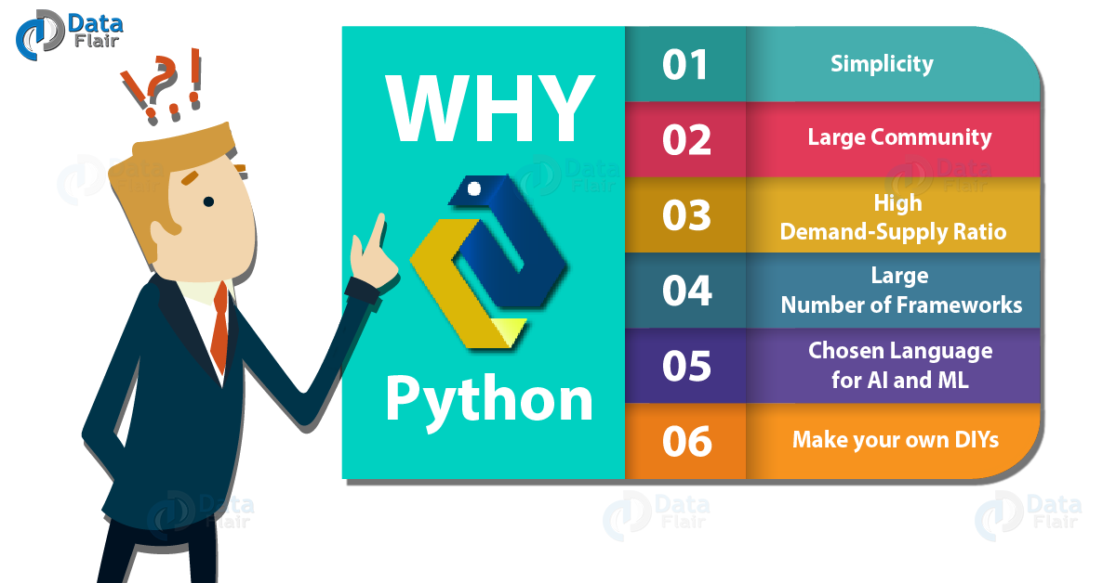
Why we choose python?

Slide 12
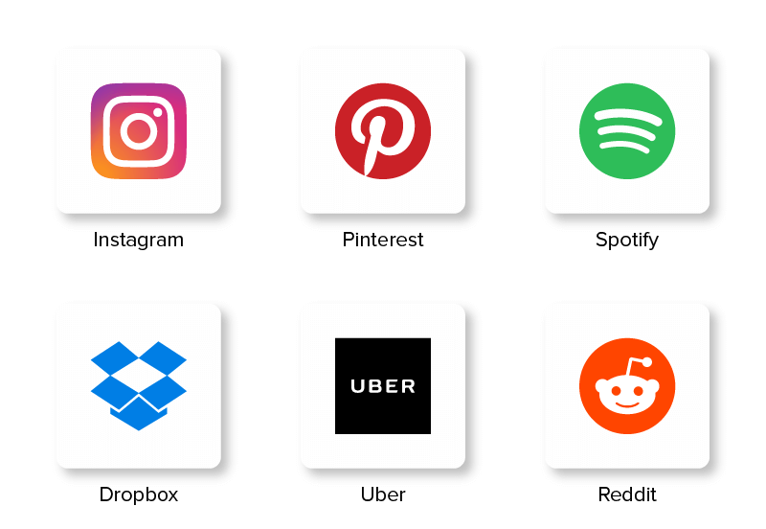
Applications that runs by Python

Slide 13
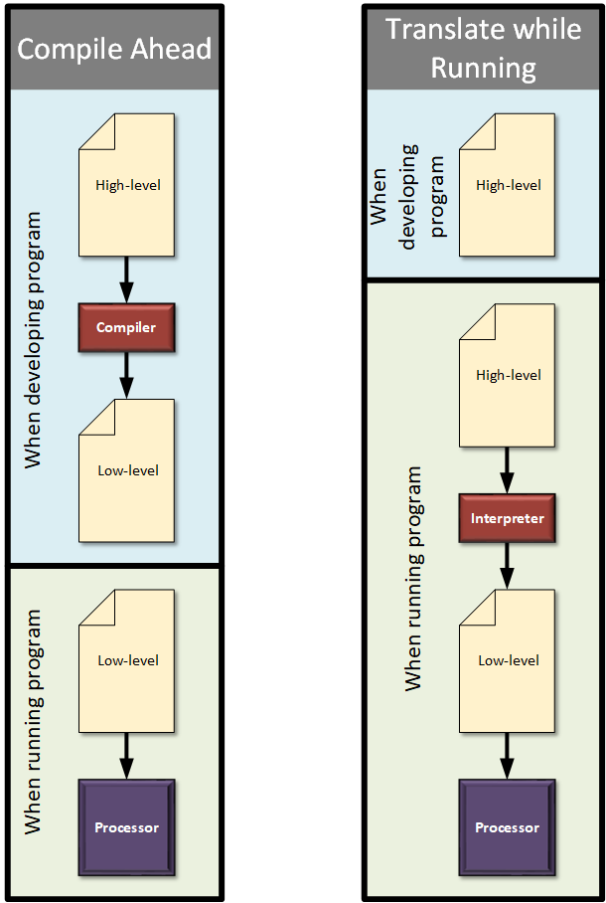
Interpreted language

Slide 14
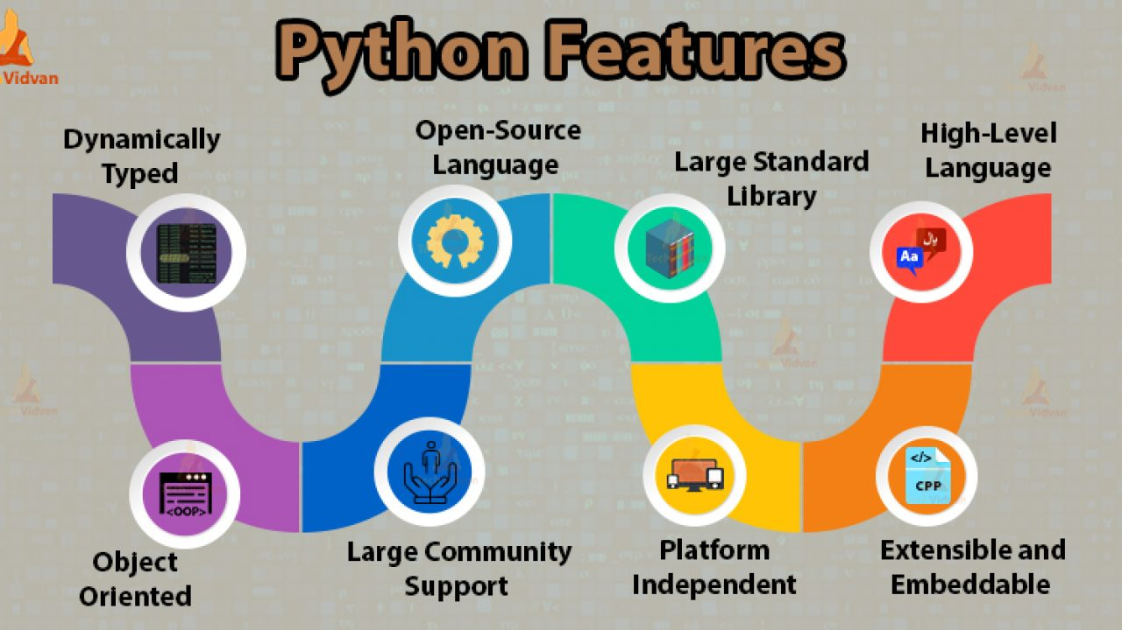

Slide 15

Python is used to do?

Slide 16
3 ways to run python:
1.Immediate mode→command prompt
2.IDLE &Script mode→New file→text editors
to save file in the format[.py]
3.IDE[Integrated Development Environment]

Slide 17
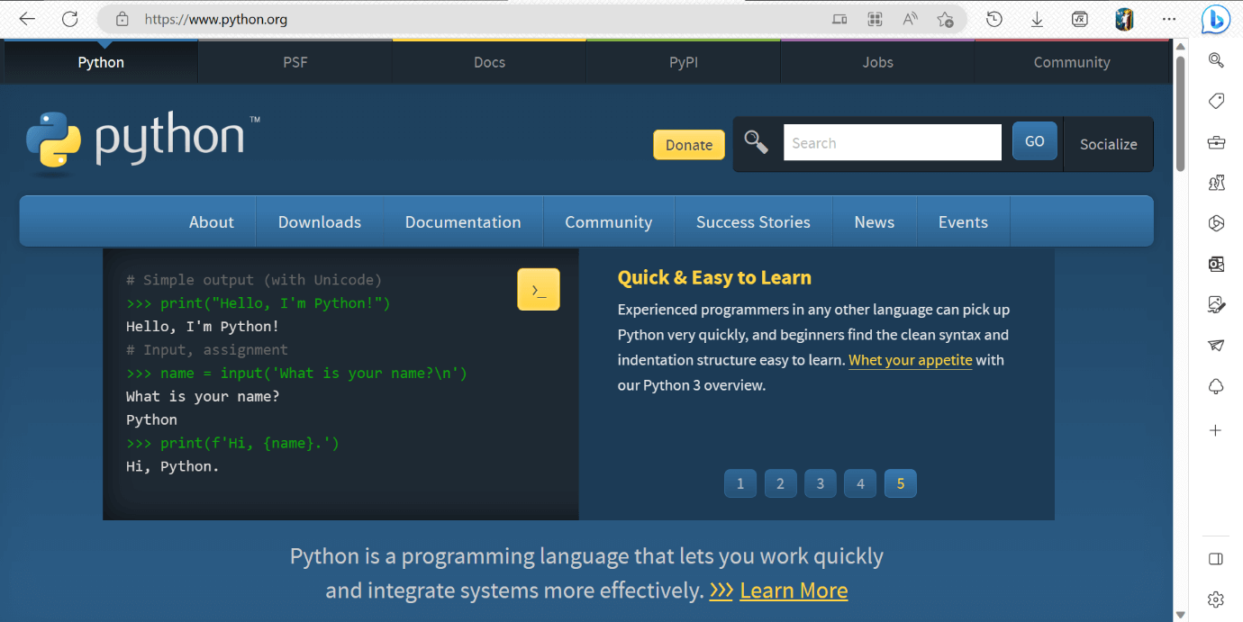
Environment set up:
step 1: Select the Python's version to download.
Click on the download button to download the exe file of Python.

Slide 18
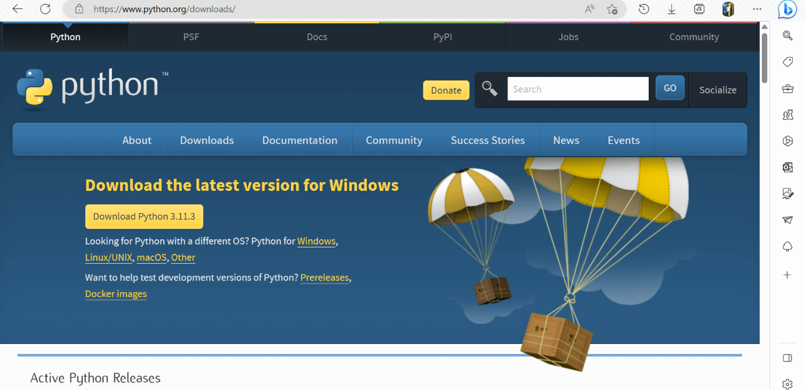
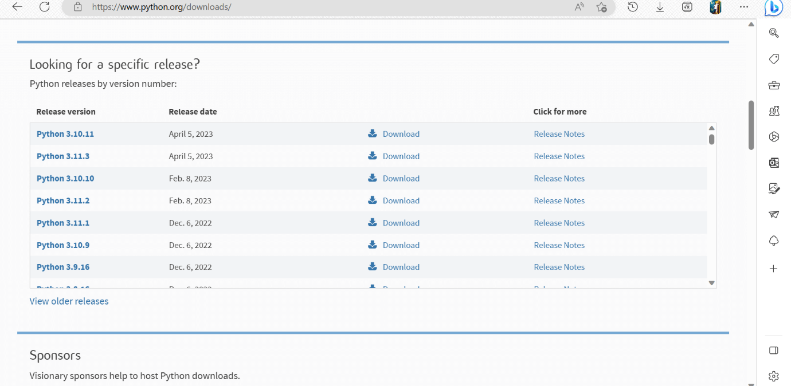

Slide 19
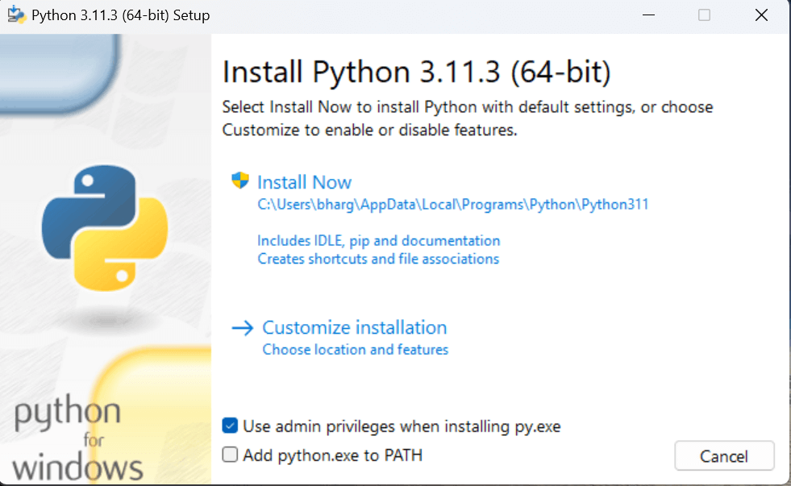
Step - 2: Click on the Install Now

Slide 20
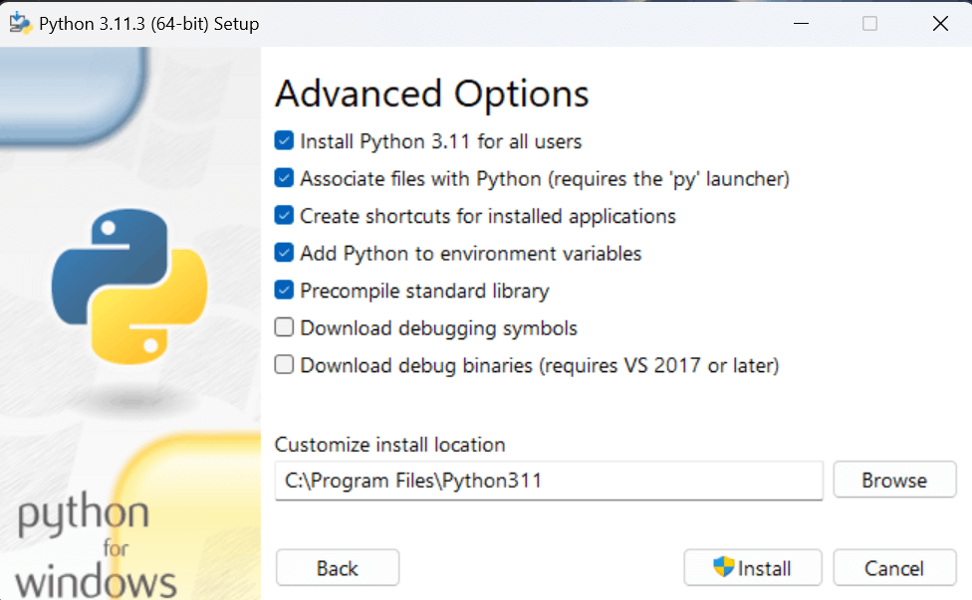
The following window will open. Click on the Add Path check box, it will set the Python path automatically.
Now, Select Customize installation and proceed. We can also click on the customize installation to choose desired location and features. Other important thing is install launcher for the all user must be checked.
Here, under the advanced options, click on the checkboxes of " Install Python 3.11 for all users ", which is previously not checked in. This will checks the other option " Precompile standard library " automatically. And the location of the installation will also be changed. We can change it later, so we leave the install location default. Then, click on the install button to finally install.

Slide 21
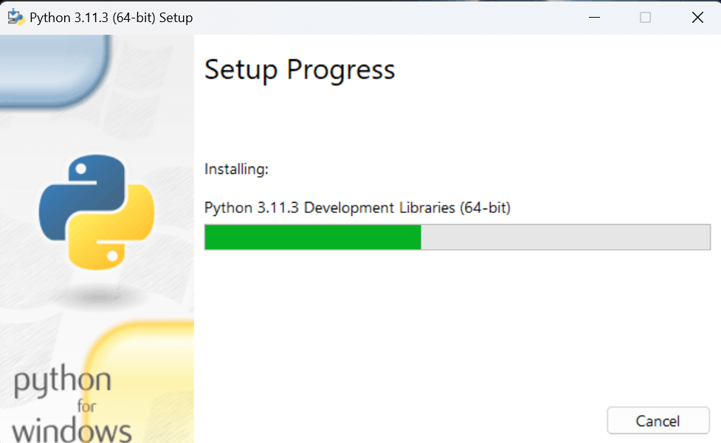
Step - 3 Installation in Process
The set up is in progress. All the python libraries, packages, and other python default files will be installed in our system. Once the installation is successful, the following page will appear saying " Setup was successful ".

Slide 22
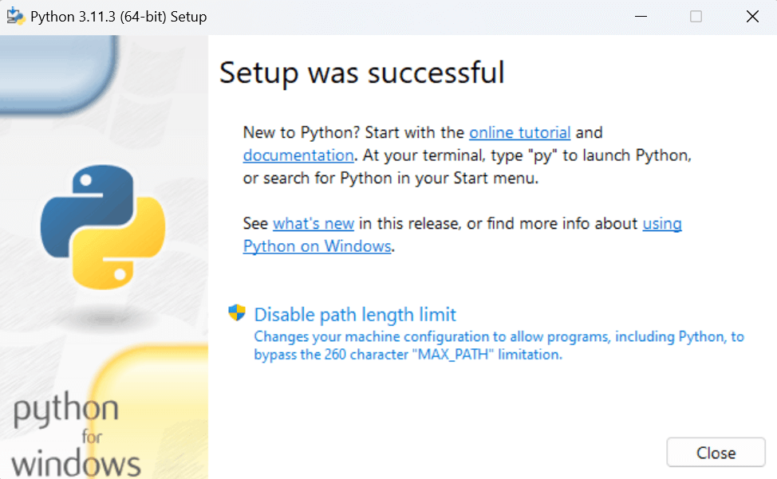
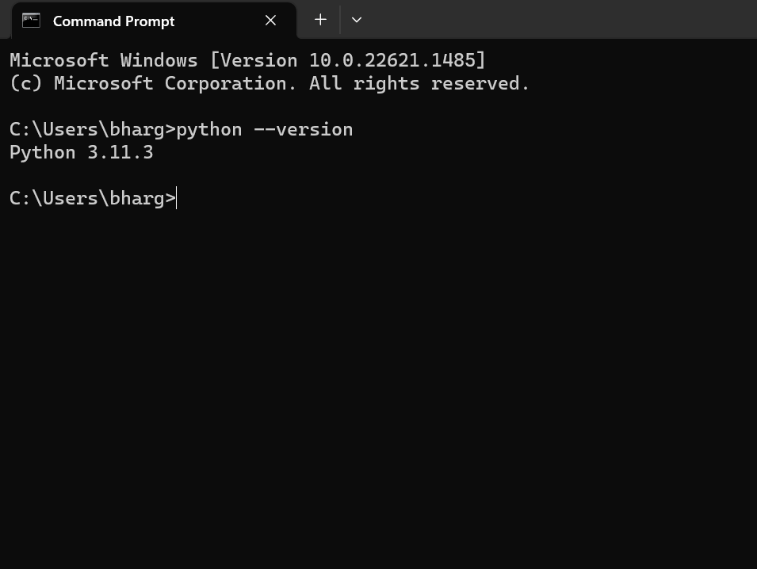
Step - 4: Verifying the Python Installation

Slide 23
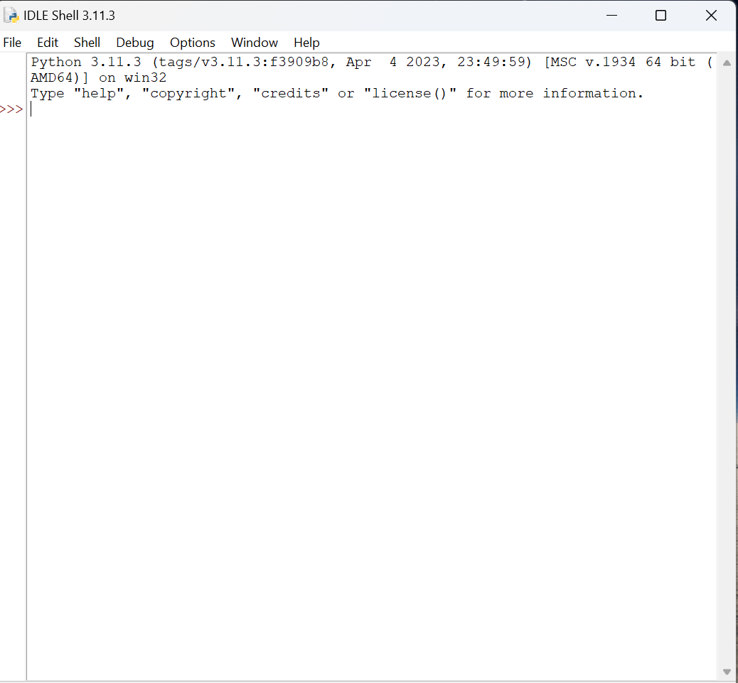
Step - 5: Opening idle

Slide 24

EDITORS

Slide 25
IDLE MODES
Idle → Integrated Development and Learning Environment
Script Mode (Used to write code)
Shell mode (Used to display output)

Slide 26
python
interpreted
interactive→communication between two side
object oriented programming language
General purpose language
machine code
output
source code→
Interpreter
Translator convert line by line

Slide 27
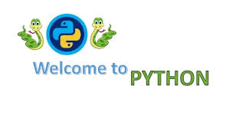
Welcome python
print(“Hello Python”)
Print(“Welcome to Our kiddos world”)
print(‘Hello World’)
print(6+5)
print(‘welcome’)

Slide 28
1.Indentation
Python uses indentation to indicate a block of code.
if 5 <2: print("Five is greater than two!")
else:
print(“lesser”)
Python will give you an error if you skip the indentation:
if 5 > 2: print("Five is greater than two!")

Slide 29
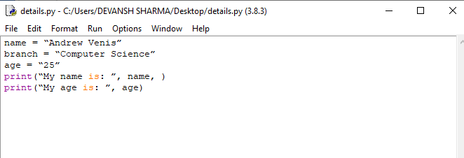
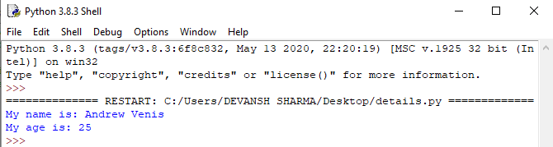
Examples:
name = "Andrew Venis"
branch = "Computer Science"
age = "25"
print("My name is: ", name, )
print("My age is: ", age)

Slide 30

2.Python comments
# Single Line Comment
”””Multi Line comment”””

Slide 31
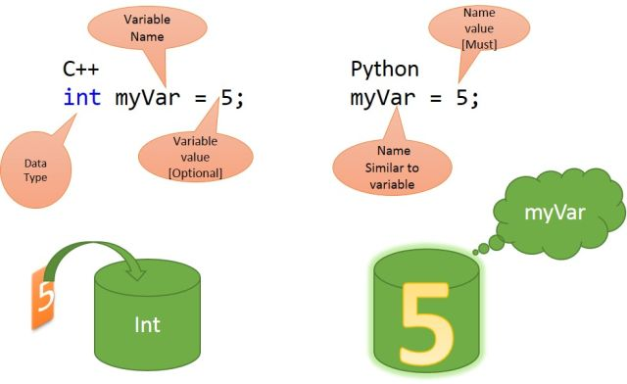
Python variables

Slide 32
Variable names
A variable can have a short name (like x and y) or a more descriptive name (0age, +carname, total_volume).
Rules for Python variables:
A variable name must start with a letter or the underscore character
A variable name cannot start with a number
A variable name can only contain alpha-numeric characters and underscores (A-z, 0-9, and _ )
Variable names are case-sensitive (age, Age and AGE are three different variables)

Slide 33
Creating variables
A variable is created the moment you first assign a value to it.
x = 3 y = ”Renu” print(x) print(y)
x = 4 # x is of type int y= “Live" # x is now of type str print(x)
print("live\twire")
print("live\nwire") Escape characters

Slide 34
Assigning variables
x, y, z = "Orange", "Banana", "Cherry”
x = y = z = "Orange“
x = "John“ x = 'John‘
x,y,z="orange","mango","apple"
print(y,"\n",x,"\n",z)
it denote same

Slide 35
Output variables
x = "awesome" print("Python is " + x)
x = "Python is " y = "awesome" z = x + y print(z)
x = 5 y = 10 print(x + y)

Slide 36
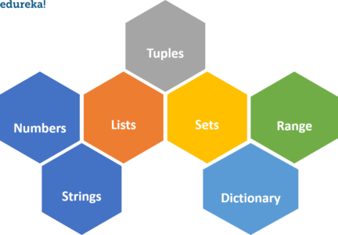
Python Data types

Slide 37
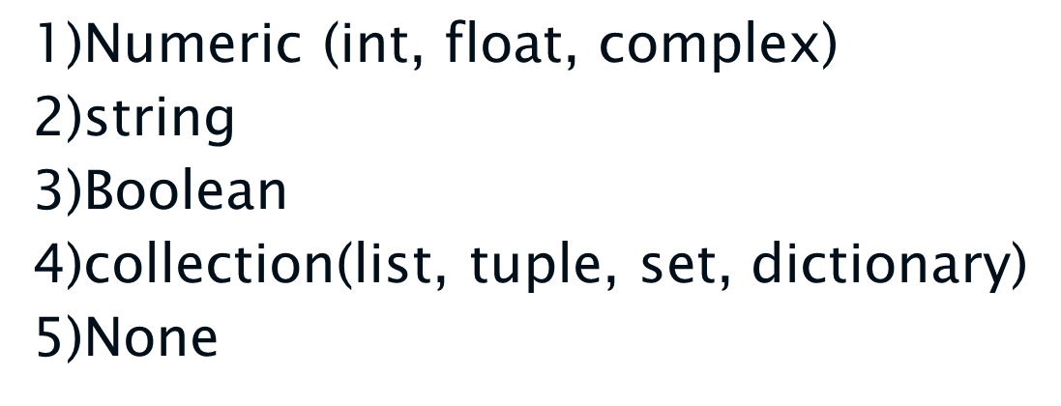

Slide 38
Python numbers
There are three numeric types in Python:
int
float
Complex
x = 1 # int y = 2.8 # float z = 5+1j # complex
print(type(x)) print(type(y)) print(type(z))

Slide 39
Type conversion
x = 17 # int y = 2.8 # float z = 1j # complex #convert from int to float: a = float(x) #convert from float to int: b = int(y) #convert from int to complex: c = complex(x) print(a) print(b) print(c) print(type(a)) print(type(b)) print(type(c))
Note: we can’t convert complex into another type

Slide 40
Python User Input
Input()
Used to getting data's from user.
Num=input()
It’s assign all values as string.
name = input("Enter your name:") print(“your name is: " + name)
address=input(“Enter your address:”)
print(“your address is:” +address )

Slide 41
If you want integer input from user convert str to int:
1.Num=int(input())→it convert string to integer
2.num=float(input())→it convert string to float
Example:
Age = int(input(“Enter your age:”)
Print(“your age is:” , age)
a=float(input(“Enter monthly salary is:”)
print(“your monthly salary is:” ,a)

Slide 42
Problem 1
1) Print Your Personal Details in the Resume Format
Ex: User Name : Your Name
User Age : Your Age
User Place : Your Place
User College : Your College
User Course : Your Course

Slide 43
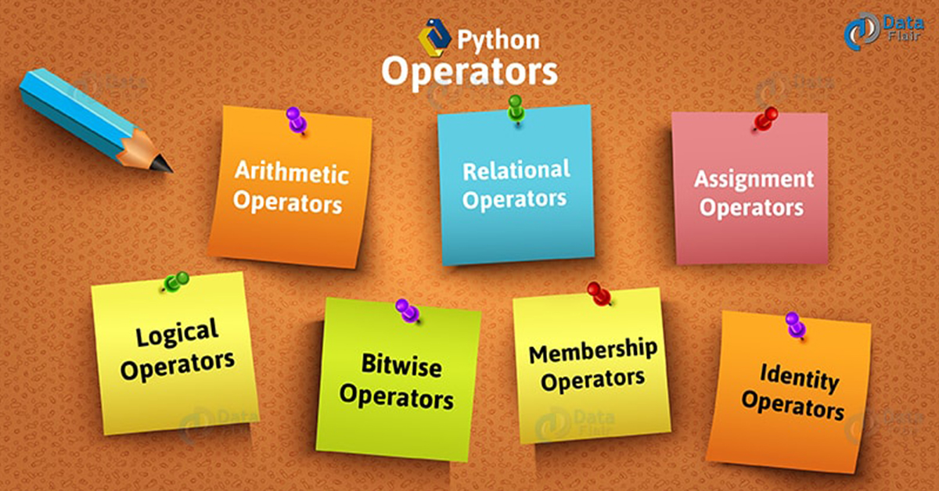
PYTHON OPERATORS

Slide 44
ARITHMETIC OPERATOR
Operators | Name | Example
+ | Addition | x + y
- | Subtraction | x - y
* | Multiplication | x * y
/ | Division | x / y
% | Modulus | x % y
** | Exponential | x ** y
// | Floor division | x // y

Slide 45
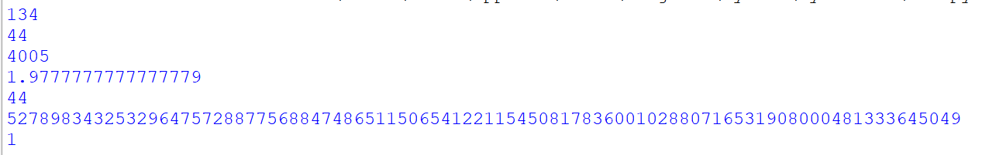
Example:
output:
a=89
b=45
print(a+b)
print(a-b)
print(a*b)
print(a/b)
print(a%b)→it returns dividend value
print(a**b)
print(a//b)→it returns quotient value
a=int(input(“Enter a:”))

Slide 46
RELATIONAL OPERATOR
Operator | Name | Example
== | Equal | x == y
!= | Not equal | x != y
> | Greater than | x > y
< | Less than | x < y
>= | Greater than or equal to | x >= y
<= | Less than or equal to | x <= y

Slide 47
Example:
Used to compare the single condition.
It’s display the output with True or False.
a=10
b=5
a>b # True
a<b # False
a==b #False
a<=6 #False
a>=6 #True
a!=b #True

Slide 48
Logical Operators
Operator | Description | Example
and | Returns True if both statements are true | x < 5 and x < 10
or | Returns True if one of the statements is true | x < 5 or x < 4
not | Reverse the result, returns False if the result is true | not(x < 5 and x < 10)

Slide 49
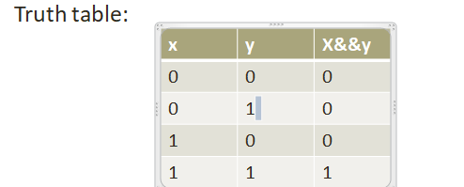
i)logical AND:
Example:
x=5
y=6
print(x > 3 and y< 10)
print(x>10 and y<9)
print(x==6 and y!=6)
output:
True
False
False

Slide 50
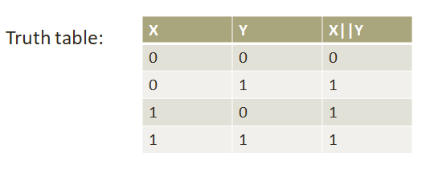
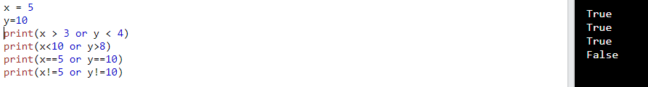
ii)Logical OR:
program:

Slide 51
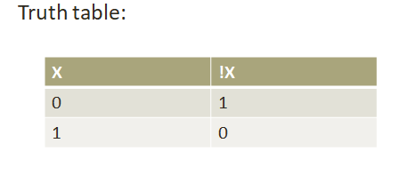
iii)Logical Not:
program:
output:

Slide 52
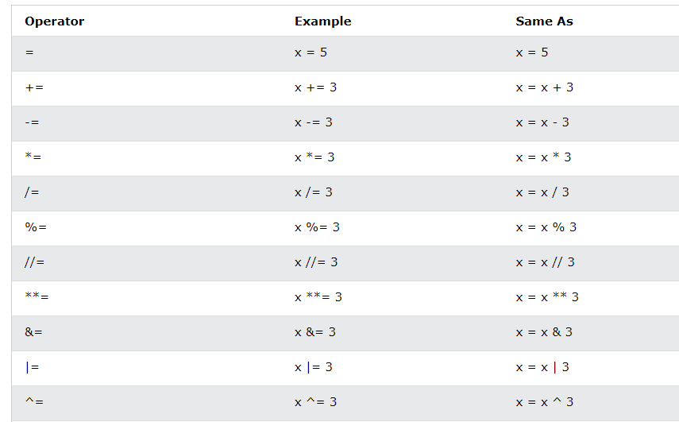
Assignment Operators
Assignment operators are used to assign values to variables

Slide 53
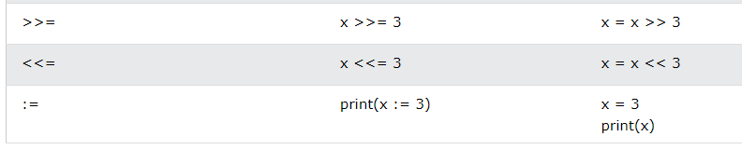
sample program:
x = 5
x+= 3
print(x)
o/p: 8
x = 5
x ^= 3
print(x)
o/p:6

Slide 54
Bitwise Operators
Operator | Name | Description
& | AND | Sets each bit to 1 if both bits are 1
| | OR | Sets each bit to 1 if one of two bits is 1
^ | XOR | Sets each bit to 1 if only one of two bits is 1
~ | Complement | Inverts all the bits
<< | Zero fill left shift | Shift left by pushing zeros in from the right and let the leftmost bits fall off
>> | Signed right shift | Shift right by pushing copies of the leftmost bit in from the left, and let the rightmost bits fall off

Slide 55
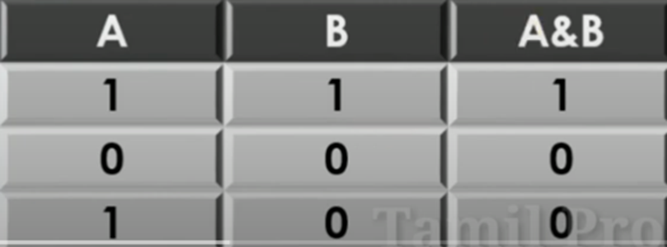
Bitwise And:
If take two numbers as operands and does AND on every bit of two numbers.
The result of AND is 1 only if both bits are 1
Ex: A=5(101),B=4(100)

Slide 56
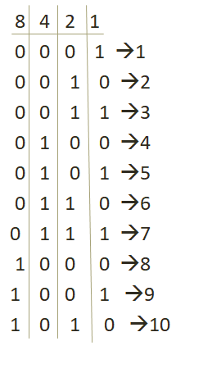
How to calculate bits?

Slide 57
sample program:
print(5&4)
o/p:4
0 1 0 1
0 1 0 0
0 1 0 0
print (6&7)
o/p:6
0 1 1 0
0 1 1 1
0 1 1 0

Slide 58
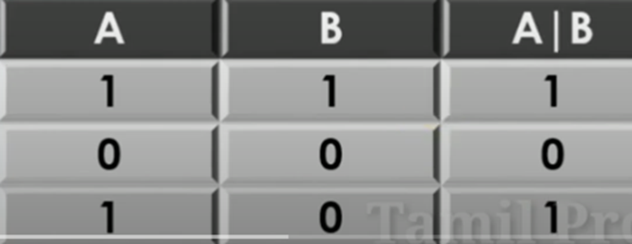
Bitwise OR:
If take two numbers as operands and does OR on every bit of two numbers.
The result of OR is 1 any of the two bits are 1
Ex: A=5(101),B=4(100)

Slide 59
sample program:
print(6 | 3)
0 1 1 0
o o 1 1
0 1 1 1
output: 7
print(9|10)
1 0 0 1
1 0 1 0
1 0 1 1
output:11

Slide 60
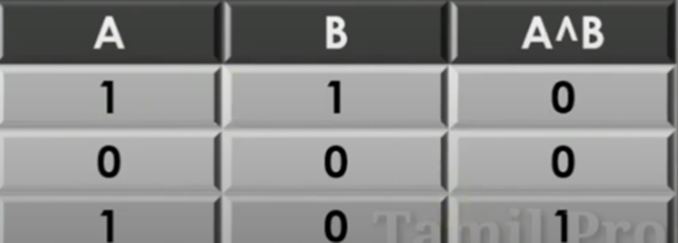
Bitwise XOR:
If take two numbers as operands and does XOR on every bit of two numbers.
The result of XOR is 1 if both bits are different.
Ex: A=5(101),B=4(100)

Slide 61
print(7^2)
0 1 1 1
0 0 1 0
0 1 0 1
output: 5
print(6 ^ 3)
0 1 1 0
0 0 1 1
0 1 0 1
output:5

Slide 62
Bitwise Not:(tilde operator)
The ~ operator inverts each bit (0 becomes 1 and 1 becomes 0).
eg: System.out.println(~3)
output: -4
o 0 1 1 0→positive
invert of 3 (1 1 0 0)
To find 2’s complement:
1 1 0 0
0 0 1 1
1→Negative
0 0 1 1
1 1 1
________
0 1 0 0 → 4

Slide 63
Formula method (another method to calculate)
a=10
~a =?
~a=-(a+1)
=-(10+1)
=-11

Slide 64
Left shift:
It take two numbers left shift the bits of first operand, the second operand define the number of places to shift.
for ex: A=5,B=2 and then result =20

Slide 65
Example:
if A=12,B=3 output: 96
A | 0 | 0 | 0 | 0 | 1 | 1 | 0 | 0
A<<B | 0 | 1 | 1 | 0 | 0 | 0 | 0 | 0

Slide 66
Right shift >>:
It take two numbers ,Right shift the bits of first operand ,the second operand define the number of places to shift.
for ex:A=5,B=2 and then result =1

Slide 67
Example:
A=10,B=3 and then result=1
A | 0 | 0 | 0 | 0 | 1 | 0 | 1 | 0
A>>B | 0 | 0 | 0 | 0 | 0 | 0 | 0 | 1

Slide 68
Identity Operators
Operator | Description | Example
is | Returns True if both variables are the same object | x is y
is not | Returns True if both variables are not the same object | x is not y

Slide 69
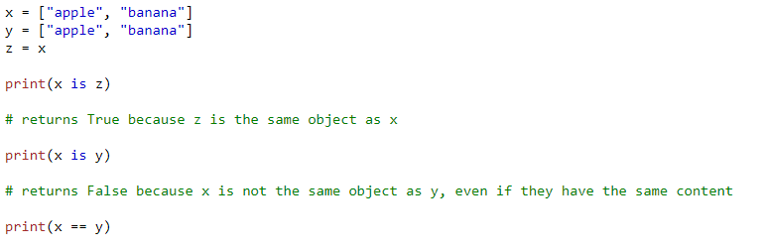
Example:
output:
True
False
True

Slide 70
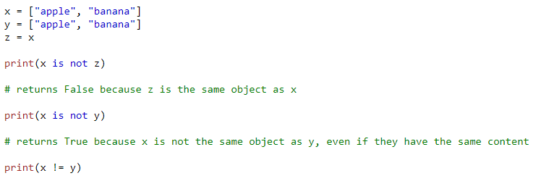
output:
False
True
False

Slide 71
Membership Operators
Operator | Description | Example
in | Returns True if a sequence with the specified value is present in the object | x in y
not in | Returns True if a sequence with the specified value is not present in the object | x not in y

Slide 72
sample program:
x = ["apple","banana","kiwi","peach","strawberry","custard
apple","orange"]
print("mango" in x) # print("mango" not in x)
print("banana" in x) # print("banana" not in x)
o/p: o/p:
False True
True False

Slide 73
Problem 2
Get 2 numbers from the user and do the following mathematical operations
Addition
Subtraction
Multiplication
Division
Write a Program to find the area of Circle
Formula:
A = pi*(r)2

Slide 74
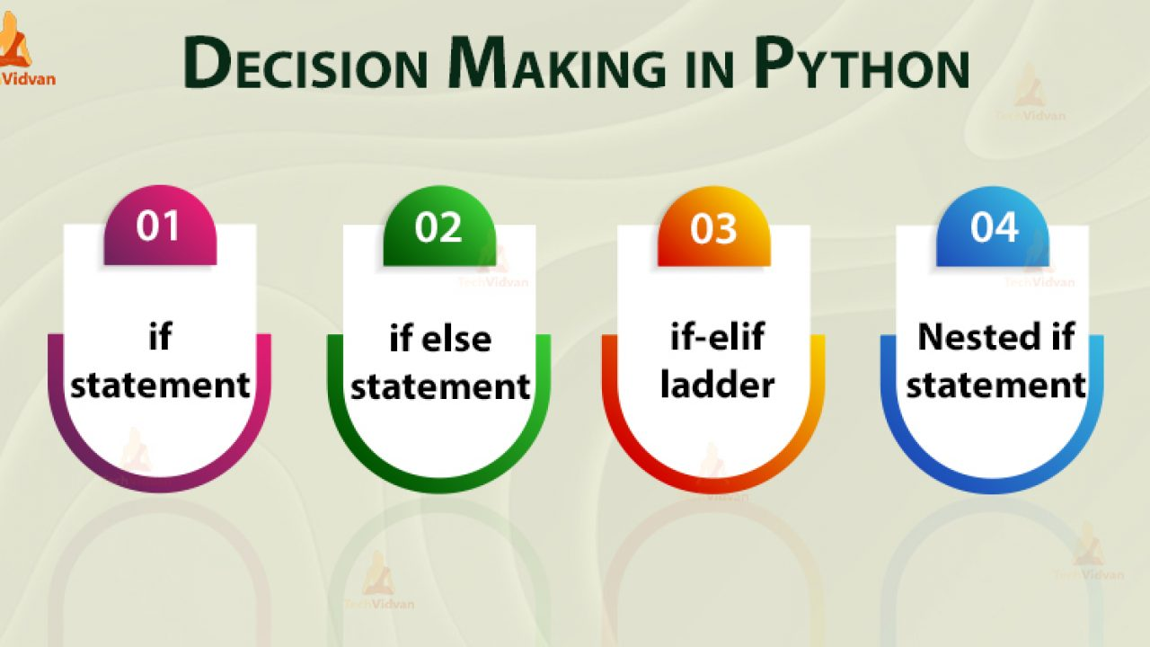

Slide 75
If
The if statement is the most simple decision-making statement. It is used to decide whether a certain statement or block of statements will be executed or not.
Syntax:
if expression:
statement(s)
ex:
a = 33 b = 200 if b <a: print("b is greater ")
else:
print(“a is greater”)
ex:
num = 8
if num > 0:
print("The number is positive.")

Slide 76
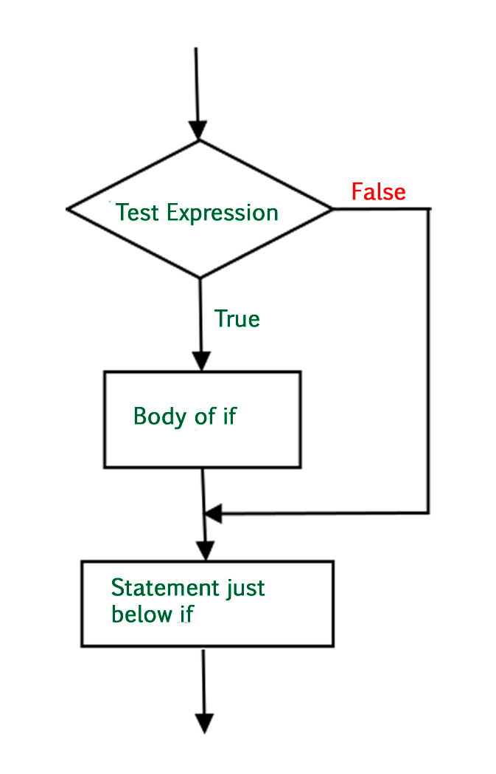
Flow Chart

Slide 77
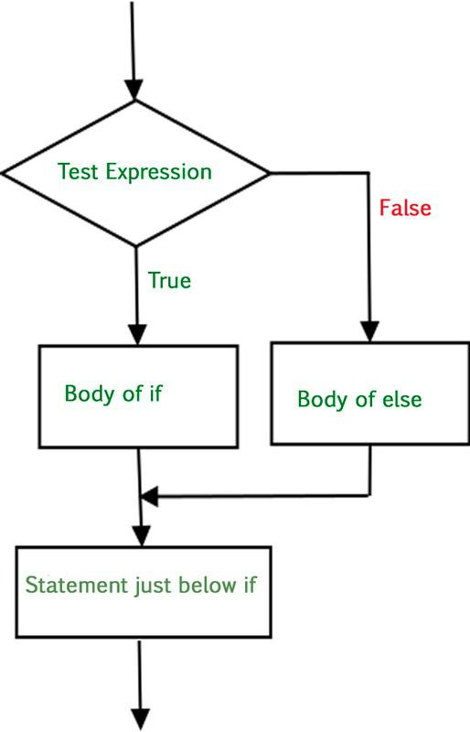
IF ELSE

Slide 78
If the condition in the if block evaluates to false, the if-else statement executes an alternate block of code.
This block of alternatives is introduced by the else keyword.
Syntax:
if expression:
statement(s)
else:
statement(s)

Slide 79
Sample program:
num = 11
if num % 2 == 0:
print("The number is even.")
else:
print("The number is odd.")
a = 200 b = 33 if b > a: print("b is greater than a") else: print("b is not greater than a")
name = “renu”
if (name==“ renu”):
print(“you find me”)
else:
print (“try again”)

Slide 80
elif(IF-elif- ELSE LADDER)
An if-elif-else ladder is an order of if statements connected by elif statements.
This enables you to check for numerous conditions and run separate code blocks based on which condition is met.
Syntax:
if condition1:
# code block 1
elif condition2:
# code block 2
elif condition3:
# code block 3
else:
# default code block

Slide 81
x = 11
if x == 2:
print("x is equal to 2")
elif x == 3:
print("x is equal to 3")
elif x == 4:
print("x is equal to 4")
else:
print("x is not equal to 2, 3, or 4")
output:?
x = {"orange","apple","pear","kiwi","peach","melon"}
if "orange" in x:
print("orange is present")
elif "pear" in x:
print("pear is present")
elif "peach" in x:
print("peach is present")
else:
print("not present")

Slide 82
Example:
a = 33 b = 33 if b > a: print("b is greater than a") elif a == b: print("a and b are equal")
elif a>b:
print(“a is greater than b")

Slide 83
Nested if
Python enables the nesting of decision-making statements, which facilitates the development of more complex decision logic.
A hierarchy of conditions can be created by an if or if-else block within another if or if-else block.
x = 41 if x > 10: print("Above ten,") if x < 20: print("and also above 20!") else: print("but not above 20.")
else:
print(“not above 10”)

Slide 84
Syntax:
if expression1:
statement(s)
if expression2:
statement(s)
elif expression3:
statement(s)
elif expression4:
statement(s)
else:
statement(s)
else:
statement(s)

Slide 85
program:
num = 3
if num > 0:
if num % 2 == 0:
print("The number is positive and even.")
else:
print("The number is positive but odd.")
else:
print("The number is not positive.")

Slide 86
Pass statement
if statements cannot be empty, but if you for some reason have an if statement with no content, put in the pass statement to avoid getting an error.
The pass statement is used when a statement is syntactically necessary, but no code is to be executed.
a = 33 b = 200 if b > a: pass

Slide 87
example:
li =['a','b','c','d']
for i in li:
if(i =='a'):
pass
else:
print(i)
for x in [0, 1, 2]:
pass
# for i in (1,7):
print(i)
n=26
if n>26:
print('Geeks')
[note: code can be used later]
n=10
if n>10:
pass
print('Hello')

Slide 88
Short hand if
A shorthand if statement is an easy way to write an if statement with a single expression. It is very useful when you have a basic condition to verify and only one action to take if that condition is met.
Short hand if
One line if statement:
if a > b: print("a is greater than b")
Short Hand If ... Else
a = 2 b = 330 print("A") if a > b else print("B")
One line if else statement, with 3 conditions:
a = 330 b = 330 print("A") if a > b else print("=") if a == b else print("B")
age = 12
message = "You can vote" if age >= 18 else "You cannot vote yet"
print(message)

Slide 89
Problem 3
1. Get 5 marks from the user. Show options as 1) Percentage 2) Total. Get option from the user and return the relevant result.
2. Get Height and weight from the user and calculate their BMI. Return the result by following conditions,
height = height/100
BMI = weight/(height)2
If,
BMI < 18 --> Under weight
18 < BMI < 25 --> Normal
26 < BMI < 30 --> Over weight
BMI > 30 --> Obesity.

Slide 90
program:
m1=int(input(“Enter the mark m1:”))
m1=85
m2=78
m3=96
m4=95
m5=100
total=m1+m2+m3+m4+m5
percentage=total/5
print(total)
print(percentage)

Slide 91
program:
height=int(input("Enter the height:"))
weight=int(input("Enter the weight:"))
#Body Mass Index
bmi=weight/(height/100)**2
if bmi<=18.5:
print("under weight")
elif bmi<=25:
print("Normal")
elif bmi<=30:
print("over weight")
else:
print("obesity")

Slide 92
Python loops
For loop
While loop
Nested Loops
Statement used with loop:
Break
Continue
Else
pass

Slide 93
1.while loop
Print i as long as i is less than 6:
i = 1 while i < 6: print(i) i+= 1
Exit the loop when i is 3: i = 1 while i < 6: o/p: 1 2 3 print(i) if i == 3: break i += 1 i=i+1
n=0
while(n<3):
n=n+1
print("Hello ")
count=0
while(count<3):
count=count+1
print("Hello Geek")
else:
print("In Else Block")

Slide 94
Continue to the next iteration if i is 3:
i = 0 while i < 6: i += 1 if i == 3: continue print(i)
i = 1 while i < 6: print(i) i += 1 else: print("i is no longer less than 6")

Slide 95
2.For loop:
Using the range() function:
for x in range(6): print(x)
Note that range(6) is not the values of 0 to 6, but the values 0 to 5.
for x in range (2,5): # start (2), ends (5-1=4)
print (x)
Increment the sequence with 3 (default is 1):
for x in range(2, 30, 3): (start,stop,step) print(x)

Slide 96
range set:
print(range(15))
print(list(range(15)))
print(list(range(4, 9)))
print(list(range(5, 25, 4)))
output:
range(0, 15)
[0, 1, 2, 3, 4, 5, 6, 7, 8, 9, 10, 11, 12, 13, 14]
[4, 5, 6, 7, 8]
[5, 9, 13, 17, 21]

Slide 97
sample program:
n=4
for i in range(0, n):
print(i)
list=["geeks", "for", "geeks"]
for i in range(len(list)):
print(list[i])
a=5
for i in range(0,a):
print(i)
list=["geeks", "for", "geeks"]
for i in list:
print(i)
language = 'Python'
# iterate over each character in language
for i in language:
print(i)
# to set range:
for i in range(2,8):
print(i)
# to set (start,end,steps)
for i in range(2,30,2):
print(i)

Slide 98
for x in range(6): (# if the loop break else part not execute) if x == 3: break print(x) else: print("Finally finished!")
a=10
for i in range(a):
# if number is divisble by 2
# then it's even
if i%2==0:
# if above condition is true
# print the number
print(i)
if i%2!=0:

Slide 99
3.Nested loops
A nested loop is a loop inside a loop.
The "inner loop" will be executed one time for each iteration of the "outer loop":
Print each adjective for every fruit:
adj = ["red", "big", "tasty"] fruits = ["apple", "banana", "cherry"] for x in adj: for y in fruits: print(x, y)

Slide 100
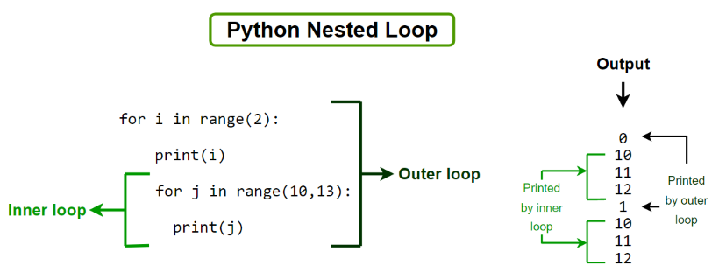

Slide 101
sample program:
x = [1, 2]
y = [4, 5]
for i in x:
for j in y:
print(i, j)
for i in range(1,8):
for j in range(i):
print(i,end=' ')
print()
adj=["red","big","tasty"]
fruits=["apple","banana","cherry"]
for x in adj:
for y in fruits:
print(x, y)
# Running outer loop from 2 to 3
for i in range(2, 4):
# Printing inside the outer loop
# Running inner loop from 1 to 10
for j in range(1, 11):
# Printing inside the inner loop
print(i, "*", j, "=", i*j)
# Printing inside the outer loop
print()

Slide 102
sample program:
for i in range(5):
print(i)
for j in range(6,9):
print(j)
break
#pass
#continue

Slide 103
program to find number palindrome or not:
num = int(input("Enter a number:"))
temp = num
reverse = 0
while temp > 0:
remainder = temp % 10
reverse = (reverse * 10) + remainder
temp = temp//10
if num == reverse:
print('Palindrome')
else:
print("Not Palindrome")

Slide 104
12→Quotient value(divide)
step 1:
num=121
temp=num
reverse=0
temp>0
121>0
remainder=121%10
=1
reverse=(reverse*10)+remainder
=(0*10)+1
=0+1
=1
temp=temp//10
=12
10
121
120
___
1→remainder(modulus)
1
step 2:
temp>0
12>0
remainder=12%10
=2
reverse=(1*10)+2
=10+2
=12
temp=12//10
=1
10
12
10
__
2

Slide 105
step3:
temp>0
1>0
remainder=1%10
=1
reverse=(12*10)+1
=120+1
=121
temp=1//0
=0→ it execute fail

Slide 106
program for to find letter palindrome:
str=input("Enter a Letter:")
if(str==str[::-1]):
print("palindrome")
else:
print("not palindrome")

Slide 107
Python string
String Literals print("Hello") print('Hello')
Assign String to a Variable
a = "Hello" print(a)
Multiline Strings
a = ""“Hi everyone welcome to livewire, we are going to learn python""" print(a)

Slide 108
sample program:
name='Livewire,tambaram'
print(name[0])
print(name[-1])
print(name[0:4])
print(name[0:])
print(name[:6])
print(name[::-1])

Slide 109
Strings are Arrays- Get the character at position 1 (remember that the first character has the position 0):
a = "Hello, World!" print(a[1])
Slicing- Get the characters from position 2 to position 5 (not included):
b = "Hello, World!" print(b[2:5])

Slide 110
Negative Indexing:
Get the characters from position 5 to position 1, starting the count from the end of the string:
b = "Hello, World!" print(b[-5:-2])
String Length:
The len() function returns the length of a string:
a = "Hello, World!" print(len(a))

Slide 111
String methods
a = "Hello, World!" print(len(a))
The strip() method removes any whitespace from the beginning or the end print(a.strip()) # returns "Hello, World!“
print(a.lower())
print(a.upper())
print(a.replace("H", “C"))
print(a.split(",")) # returns ['Hello', ' World!']
print(a.title())
txt = "I love apples, apple are my favorite fruit" x = txt.count("apple") print(x)

Slide 112
Examples:
name='livewire,tambaram'
print(name.upper())
print(name.lower())
print(name.capitalize())
print(name.title())
print(name.index('e'))
print(name.rindex('e'))
print(name.find('e'))
print(name.rfind('i'))
print(name.startswith('Li'))
print(name.endswith('re'))
output:
LIVEWIRE,TAMBARAM
livewire,tambaram
Livewire,tambaram
Livewire,Tambaram
3
7
3
5
False
False

Slide 113
print(name.count('a'))
print(name.replace('i','I'))
print(len(name))
print(name.strip())
print(name.split(','))
num='12345'
print('-'.join(num))
print(num.isdigit())
print(name.isalpha())
print(num.isalnum())
print(num.isspace())
print(name.isidentifier())
ex='hai\thello'
print(num.center(20))
print(ex.expandtabs(20))
output:
3
lIvewIre,tambaram
livewire,tambaram
17
['livewire', 'tambaram']
1-2-3-4-5
True
False
True
False
False
12345
hai hello

Slide 114
Check String
txt = "The rain in Spain stays mainly in the plain" x = "ain" in txt print(x)
txt = "The rain in Spain stays mainly in the plain" x = "ain" not in txt print(x)

Slide 115
String concatenation
a = "Hello" b = "World" c = a + b print(c)
a = "Hello" b = "World" c = a + " " + b print(c)

Slide 116
String format
age = 36 txt = "My name is John, I am " ,age print(txt) #error
Use the format() method to insert numbers into strings:
age = 36 txt = "My name is John, and I am {}" print(txt.format(age))
The format() method takes unlimited number of arguments, and are placed into the respective placeholders:
quantity = 3 itemno = 567 price = 49 myorder = "I want {} pieces of item {} for {} dollars." print(myorder.format(quantity, itemno, price))

Slide 117
example:
sent='i am {name} from {place}'
print(sent.format(name='mounika',place='mayiladuthurai'))
print(sent.format(name='abcd',place='chennai'))
print(sent.format(place='madras',name='xyz'))
output:
i am mounika from mayiladuthurai
i am abcd from chennai
i am xyz from madras

Slide 118
Document String:
story='''While drawing in class at Stagwood School, 12-year old Cal sees a frog staring at him through the window. Stranger than that, is the fact that this frog happens to be wearing glasses. '''
print(story)

Slide 119
Join():
The join() method takes all items in an iterable and joins them into one string.
A string must be specified as the separator.
Join all items in a tuple into a string, using a hash character as separator:
m = ("John", "Peter", "Vicky") x = "#".join(m)
print(x)
output:
John#Peter#Vicky

Slide 120
Collection data types
List is a collection which is ordered and changeable. Allows duplicate members.
Tuple is a collection which is Ordered and unchangeable. Allows duplicate members.
Set is a collection which is unordered and un-indexed. No duplicate members.
Dictionary is a collection which is ordered, changeable and indexed. No duplicate members.

Slide 121
list
Create a List:
list= ["apple", "banana", "cherry"] print(list)
Access Items:
You access the list items by referring to the index number:
list = ["apple", "banana", "cherry"] print(list[1])
output: banana

Slide 122
Negative Indexing list = ["apple", "banana", "cherry"] print(list[-1])
output:cherry
Range of Indexes:
You can specify a range of indexes by specifying where to start and where to end the range.
list=["apple", "banana", "cherry", "orange", "kiwi", "melon", "mango"] print(list[2:5])

Slide 123
By leaving out the start value, the range will start at the first item:
list=["apple", "banana", "cherry", "orange", "kiwi", "melon", "mango"] print(list[:4])
By leaving out the end value, the range will go on to the end of the list:
list=["apple", "banana", "cherry", "orange", "kiwi", "melon", "mango"] print(list[2:])

Slide 124
Range of Negative Indexes
This example returns the items from index -4 (included) to index -1 (excluded)
list = ["apple", "banana", "cherry", "orange", "kiwi", "melon", "mango"] print(list[-4:-1])
output: [ "orange", "kiwi", "melon“, ”mango”]

Slide 125
Change Item Value:
list = ["apple", "banana", "cherry"] list[1] = "blackcurrant" print(list)
Loop Through a List
list = ["apple", "banana", "cherry"] for x in list: print(x)
Check if Item Exists
list = ["apple", "banana", "cherry"] if "apple" in list: print("Yes, 'apple' is in the fruits list")

Slide 126
List methods
list=["apple","banana","cherry"]
print(len(list))
list.append("orange")
print(list)
list.insert(1,"orange")
print(list)
list.remove("banana")
print(list)
list.pop()
print(list)

Slide 127
…..
del list[0] print(list)
del list
Print(list)
list.clear() print(list)
mylist = list.copy() print(mylist)

Slide 128
…….
Join two list:
list1 = ["a", "b" , "c"] list2 = [1, 2, 3] list3 = list1 + list2 print(list3)
Append list2 into list1:
list1 = ["a", "b" , "c"] list2 = [1, 2, 3] for x in list2: list1.append(x)
print(list1)

Slide 129
Use the extend() method to add list2 at the end of list1:
list1 = ["a", "b" , "c"] list2 = [1, 2, 3] list1.extend(list2) print(list1)

Slide 130
Python tuple
A tuple is a collection which is ordered and unchangeable. In Python tuples are written with round brackets.
Create a Tuple:
tuple = ("apple", "banana", "cherry") print(tuple)
Access Tuple Items:
tuple = ("apple", "banana", "cherry") print(tuple[1])

Slide 131
……
Negative Indexing
thistuple = ("apple", "banana", "cherry") print(thistuple[-1])
Range of Indexes
thistuple = ("apple", "banana", "cherry", "orange", "kiwi", "melon", "mango") print(thistuple[2:5])
print(thistuple[-4:-1])

Slide 132
Change tuple values
x = ("apple", "banana", "cherry") y = list(x) y[1] = "kiwi" x = tuple(y) print(x)

Slide 133
……..
Loop through a tuple:
tuple = ("apple", "banana", "cherry") for x in tuple: print(x)
Check if Item Exists
thistuple = ("apple", "banana", "cherry") if "apple" in thistuple: print("Yes, 'apple' is in the fruits tuple")

Slide 134
…..
thistuple = ("apple", "banana", "cherry") del thistuple print(thistuple) #this will raise an error because the tuple no longer exists
Join two tuples:
tuple1 = ("a", "b" , "c") tuple2 = (1, 2, 3) tuple3 = tuple1 + tuple2 print(tuple3)

Slide 135
thistuple = ("apple", "banana", "cherry") print(len(thistuple))
You cannot add items to a tuple:
thistuple = ("apple", "banana", "cherry") thistuple[3] = "orange" # This will raise an error print(thistuple)

Slide 136
Python set
A set is a collection which is unordered and unindexed. In Python sets are written with curly brackets.
Create a Set:
set = {"apple", "banana", "cherry"} print(set)

Slide 137
Access an item
You cannot access items in a set by referring to an index, since sets are unordered the items has no index.
But you can loop through the set items using a for loop, or ask if a specified value is present in a set, by using the in keyword.
Example
Loop through the set, and print the values:
thisset = {"apple", "banana", "cherry"} for x in thisset: print(x)

Slide 138
……
Check if "banana" is present in the set:
thisset = {"apple", "banana", "cherry"} print("banana" in thisset)
Change Items:
Once a set is created, you cannot change its items, but you can add new items.
Add Items
To add one item to a set use the add() method.
To add more than one item to a set use the update() method.
Example:
Add an item to a set, using the add() method:
thisset = {"apple", "banana", "cherry"} thisset.add("orange") print(thisset)

Slide 139
……
Add multiple items to a set, using the update() method:
thisset = {"apple", "banana", "cherry"} thisset.update(["orange", "mango", "grapes"]) print(thisset)
Get the number of items in a set:
thisset = {"apple", "banana", "cherry"} print(len(thisset))

Slide 140
Remove an item
To remove an item in a set, use the remove(), or the discard() method. thisset = {"apple", "banana", "cherry"} thisset.remove("banana") print(thisset)
Note: If the item to remove does not exist, remove() will raise an error.
thisset.discard("banana") print(thisset)
Note: If the item to remove does not exist, discard() will NOT raise an error.

Slide 141
Pop method
You can also use the pop(), method to remove an item, but this method will remove the last item. Remember that sets are unordered, so you will not know what item that gets removed.
The return value of the pop() method is the removed item.
Example:
Remove the last item by using the pop() method:
thisset = {"apple", "banana", "cherry"} x = thisset.pop() print(x) print(thisset)

Slide 142
Clear and delete
The clear() method empties the set:
thisset = {"apple", "banana", "cherry"} thisset.clear() print(thisset)
The del keyword will delete the set completely:
Del thisset
Print(thisset)

Slide 143
…….
The union() method returns a new set with all items from both sets:
set1 = {"a", "b" , "c"} set2 = {1, 2, 3} set3 = set1.union(set2) print(set3)
The update() method inserts the items in set2 into set1:
set1 = {"a", "b" , "c"} set2 = {1, 2, 3} set1.update(set2) print(set1)

Slide 144
Python Dictionary
A dictionary is a collection which is ordered, changeable and un-indexed. In Python dictionaries are written with curly brackets, and they have keys and values.
Create and print a dictionary:
d= {"brand": “Audi", "model": “2020"} print(dict)

Slide 145
Accessing items
You can access the items of a dictionary by referring to its key name, inside square brackets:
Get the value of the "model" key:
x = d["model"]
There is also a method called get() that will give you the same result:
x = d.get("model")

Slide 146
……
You can change the value of a specific item by referring to its key name:
dict = {"brand": “Maruthi susuki","model": “celerio", "year": 2019 } dict["year"] = 2020
print(dict)

Slide 147
Loop through a dictionary
Print all key names in the dictionary, one by one:
for x in dict: print(x)
Print all key names in the dictionary, one by one:
for x in thisdict: print(x)
You can also use the values() method to return values of a dictionary:
for x in thisdict.values(): print(x)
Loop through both keys and values, by using the items() method:
for x, y in thisdict.items(): print(x, y)

Slide 148
........
Check if "model" is present in the dictionary:
thisdict = { "brand": "Ford", "model": "Mustang", "year": 1964 } if "model" in thisdict: print("Yes, 'model' is one of the keys in the thisdict dictionary")

Slide 149
……
Print the number of items in the dictionary:
print(len(thisdict))
Adding Items:
Adding an item to the dictionary is done by using a new index key and assigning a value to it:
thisdict = { "brand": "Ford", "model": "Mustang", "year": 1964 } thisdict["color"] = "red" print(thisdict)

Slide 150
Removing items
The pop() method removes the item with the specified key name:
thisdict = { "brand": "Ford", "model": "Mustang", "year": 1964 } thisdict.pop("model") print(thisdict)
The popitem() method removes the last inserted item (in versions before 3.7, a random item is removed instead):
thisdict = { "brand": "Ford", "model": "Mustang", "year": 1964 } thisdict.popitem() print(thisdict)

Slide 151
……
The del keyword removes the item with the specified key name:
thisdict = { "brand": "Ford", "model": "Mustang", "year": 1964 } del thisdict["model"] print(thisdict)
The del keyword can also delete the dictionary completely:
thisdict = { "brand": "Ford", "model": "Mustang", "year": 1964 } del thisdict print(thisdict) #this will cause an error because "thisdict" no longer exists

Slide 152
……
The clear() method empties the dictionary:
thisdict = { "brand": "Ford", "model": "Mustang", "year": 1964 } thisdict.clear() print(thisdict)

Slide 153
Copy a dictionary
Make a copy of a dictionary with the copy() method:
thisdict = { "brand": "Ford", "model": "Mustang", "year": 1964 } mydict = thisdict.copy() print(mydict)

Slide 154
……
Make a copy of a dictionary with the dict() function:
thisdict = { "brand": "Ford", "model": "Mustang", "year": 1964 } mydict = dict(thisdict) print(mydict)

Slide 155
Nested dictionaries
A dictionary can also contain many dictionaries, this is called nested dictionaries.
myfamily = {"child1" : { "name" : "Emil","year" : 2004}, "child2" : { "name" : "Tobias", "year" : 2007}, "child3" : {"name" : "Linus","year" : 2011 }}

Slide 156
…….
Create three dictionaries, then create one dictionary that will contain the other three dictionaries:
child1 = { "name" : "Emil", "year" : 2004 } child2 = { "name" : "Tobias", "year" : 2007 } child3 = { "name" : "Linus", "year" : 2011 } myfamily = { "child1" : child1, "child2" : child2,"child3" : child3}

Slide 157
Functions
A function is a block of code which only runs when it is called.
You can pass data, known as parameters, into a function.
A function can return data as a result.
Functions are classified as built-in functions
Pre-Defined Functions
User-Defined Functions.

Slide 158
Pre-Defined Function
The Python built-in functions are defined as the functions whose functionality is pre-defined in Python. Ex. print(), input(), list(), int(), float() etc..,
There are several built-in functions in Python which are listed below:

Slide 159
Ex: Print(),input(),int(),float(),string(),list(),range()…
Pow(base, power)🡪 to find power of given value.
bin(value)🡪 to find binary value of given value.
oct(value)🡪 to find octal value of given value.
hex(value)🡪to find hexa value of given value.
eval()🡪 it accepts all type of datatypes.

Slide 160
Built-in Functions
S.NO | Function | Description
1 | abs() | The python abs() function is used to return the absolute value of a number.
2 | all() | The python all() function accepts an iterable object (such as list, dictionary, etc.). It returns true if all items in passed iterable are true.
3 | any() | The python any() function returns true if any item in an iterable is true.
4 | bin() | The python bin() function is used to return the binary representation of a specified integer.
5 | sum() | As the name says, python sum() function is used to get the sum of numbers of an iterable, i.e., list.
6 | len() | The python len() function is used to return the length (the number of items) of an object.
7 | help() | used to get information.

Slide 161
Creating and calling function
In Python a function is defined using the def keyword:
Example
def my_function(): def call(): print("Hello from a function")
Calling a Function
To call a function, use the function name followed by parenthesis:
Example
def my_function(): print("Hello from a function") my_function()

Slide 162
Functions
Function without Parameter / Argument.
Function with Parameter / Argument.
Function with number of Parameters.
Function with Arbitary argument
Function with keyword argument
Function with keyword arbitary
Function with default argument.
Function with Pass statement
Function with iteratable as an argument
Function with return statement
Recursion
Lambda

Slide 163
Example:
1.without argument non return
def add():
print(6+5)
add()
2.with agument non return
def add(a,b):
print(a+b)
add(56,3)
3.without argu return
def display():
return 'this is sample'
print(display())
a=display()
print(a)
4.with argu with return
def ret(a,b):
return a+b
//print(ret(34,66))
a=ret(34,66)
print(a)

Slide 164
Arguments
Information can be passed into functions as arguments.
Arguments are specified after the function name, inside the parentheses. You can add as many arguments as you want, just separate them with a comma.

Slide 165
The following example has a function with one argument (fname). When the function is called, we pass along a first name, which is used inside the function to print the full name:
Example:
def my_func(fname): print(fname + ” ”+Robert”) my_func("Emil“,) my_func("Tobias") my_func("Linus")

Slide 166
def hai(name,message):
print("hi",name+ " "+message)
hai("james","good morning!!!")
o/p:
?

Slide 167
Number of arguments
By default, a function must be called with the correct number of arguments. Meaning that if your function expects 2 arguments, you have to call the function with 2 arguments, not more, and not less.
Example:
This function expects 2 arguments, and gets 2 arguments.

Slide 168
def my_func(fname,lname):
print(fname + " " +lname)
my_func("Emil","albert")
my_func("Tobias","maris")
my_func("Linus","mathew")
output:
Emil albert
Tobias maris
Linus mathew
def my_func(fname,lname,age):
print(fname + " " +lname+ " "+age)
my_func("Emil","albert","32")
my_func("Tobias","maris","24")
my_func("Linus","mathew","32")
output:
Emil albert 32
Tobias maris 24
Linus mathew 32

Slide 169
The terms parameter and argument can be used for the same thing: information that are passed into a function.
A parameter is the variable listed inside the parentheses in the function definition.
An argument is the value that are sent to the function when it is called.

Slide 170
Arbitrary Arguments, *args
If you do not know how many arguments that will be passed into your function, add a * before the parameter name in the function definition.
This way the function will receive a tuple of arguments, and can access the items accordingly:
It can be used for random arguments.

Slide 171
Example:
def demo(*values):
for i in values:
print(i)
demo(12,34,56,78,98,87,76,65,56,43,32,13)
output:
12
34
56
78
98
87
76
65
56
43
32
13
def demo(*a):
print(a)
demo(10,20,30)
output: 10 20 30
def demo(a,b):
print(a,b)
demo(10,20)
output: 10 20
def demo(*n):
print(n)
demo(34,78,4,6)
output:
34
78
4
6

Slide 172
Example:
If the number of arguments is unknown, add a * before the parameter name:
def my_func(*kids): print("The youngest child is " + kids[2]) my_func("Emil", "Tobias", "Linus“,”mathew”,”tom”)
output:?
def arbit(*n):
print(n)
arbit(34,78,4,6)
output: ?

Slide 173
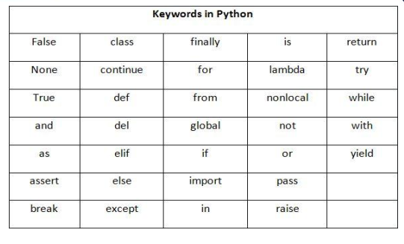
33 keywords:

Slide 174
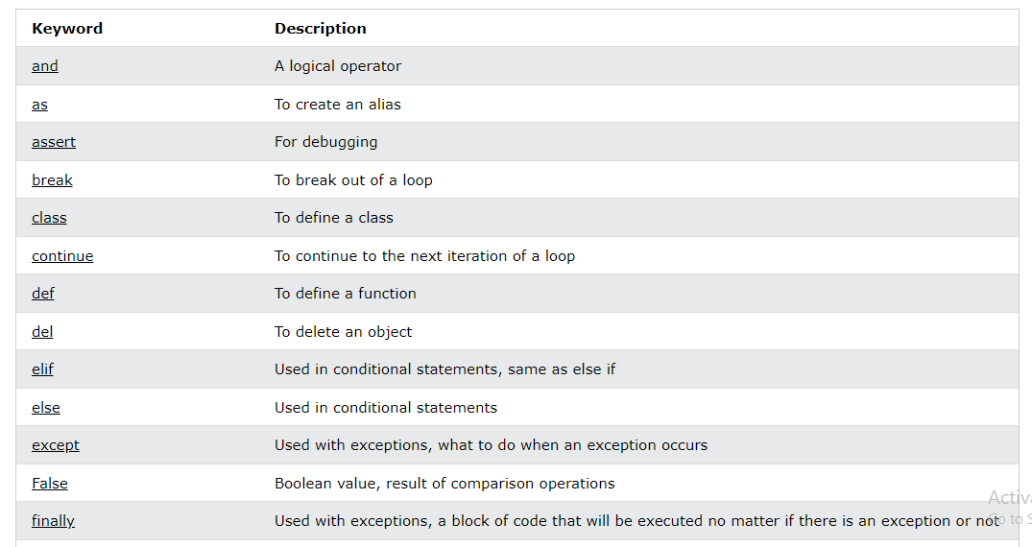

Slide 175
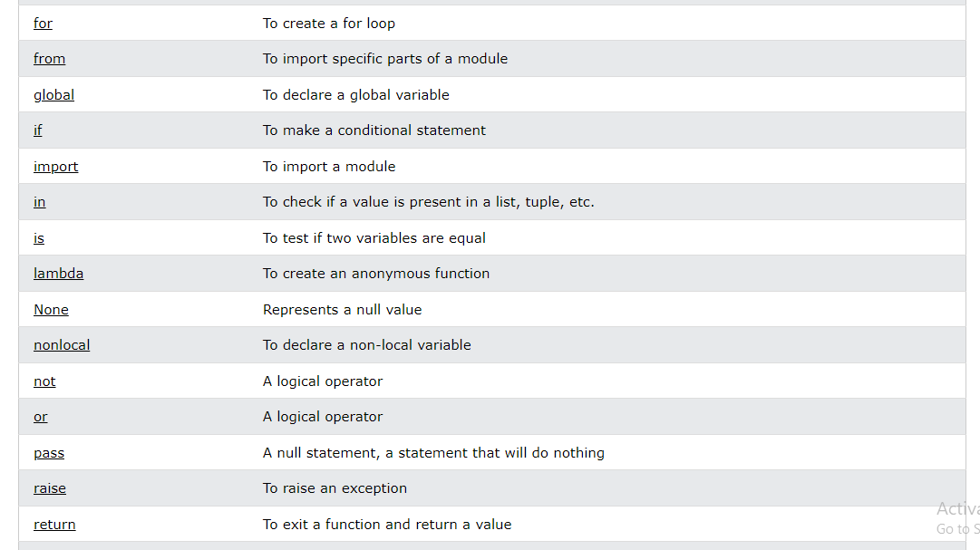

Slide 176
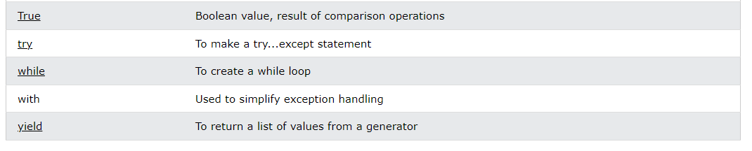

Slide 177
Keyword argument
You can also send arguments with the key = value syntax.
This way the order of the arguments does not matter.
Example:
def my_function(child3, child2, child1): print("The youngest child is " + child3) my_function(child1 = "Emil", child2 = "Tobias", child3 = "Linus")
output:?
def key(b,a):
print(a-b)
key(a=89,b=22)
output: ?

Slide 178
Arbitrary keyword arguments
Arbitrary Keyword Arguments, **kwargs
If you do not know how many keyword arguments that will be passed into your function, add two asterisk: ** before the parameter name in the function definition.
This way the function will receive a dictionary of arguments, and can access the items accordingly:
Example:
If the number of keyword arguments is unknown, add a double ** before the parameter name:

Slide 179
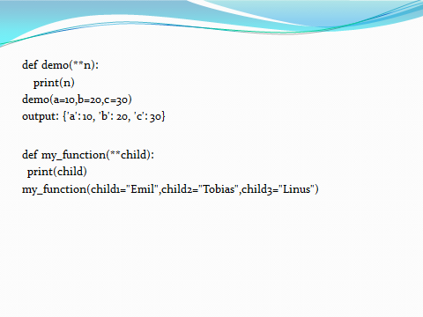
def my_function(**kid):
print("His last name is "+kid["lname"])
my_function(fname="Tobias",lname="Robert ")

Slide 180
default argument:
def hai(name,message="good morning!!"):
print("hi",name+ " "+message)
hai("james")
hai("james","How are you?")
output:???

Slide 181
Default parameter value
The following example shows how to use a default parameter value.
If we call the function without argument, it uses the default value:
Example
def my(country = "Norway"): print("I am from " + country) my("Sweden") my("India") my() my("Brazil")

Slide 182
Passing a list as an argument
You can send any data types of argument to a function (string, number, list, dictionary etc.), and it will be treated as the same data type inside the function.
E.g. if you send a List as an argument, it will still be a List when it reaches the function:
Example
def my(food): for x in food: print(x) fruits = ["apple", "banana", "cherry"] my(fruits)

Slide 183
Return values
To let a function return a value, use the return statement:
Example
def call(x): return 5 * x print(call(3)) print(call(5)) print(call(9))

Slide 184
The pass statement
function definitions cannot be empty, but if you for some reason have a function definition with no content, put in the pass statement to avoid getting an error.
Example
def myfunction(): pass
def my_func(x):
return 5*x
def call():
pass
print(my_func(3))
print(my_func(5))
print(my_func(9))

Slide 185
Recursion
Python also accepts function recursion, which means a defined function can call itself.
Recursion is a common mathematical and programming concept. It means that a function calls itself. This has the benefit of meaning that you can loop through data to reach a result.

Slide 186
1
Example:
def Rec(n):
if(n == 0):
return 1
else:
return n * Rec(n-1)
print(Rec(6))
output: 720
1*fact(0)
2*fact(1)
3*fact(2)
4*fact(3)
5*fact(4)
6*fact(5)
6*5*4*3*2*1=720

Slide 187
1
def fun(n):
if(n==1):
return 1
else:
return n+fun(n-1)
print(fun(6))
output:? 6+5+4+3+2+1→21
2+fact(1)
3+fact(2)
4+fact(3)
5+fact(4)
6+fact(5)

Slide 188
def hello(n):
if n==1:
return 1
print('hello',n)
hello(n-1)
hello(10)
output:?

Slide 189
Lambda
A lambda function is a small anonymous function.
A lambda function can take any number of arguments, but can only have one expression.
Syntax
lambda arguments : expression
The expression is executed and the result is returned:
Example
A lambda function that adds 10 to the number passed in as an argument, and print the result:
x = lambda a,b : a + 10+b →15 print(x(5,6))

Slide 190
It can be used temporary inside in function
Lambda functions can take any number of arguments:
Example
A lambda function that multiplies argument a with argument b and print the result:
x = lambda a, b : a * b→30 print(x(5, 6))
x=lambda a,b:a+10*b
print(x(5,6))

Slide 191
….
Example
A lambda function that sums argument a, b, and c and print the result:
x = lambda a, b, c : a + b + c print(x(5, 6, 2))

Slide 192
double=lambda a:a*20
print(double(10))
output:200
double=lambda a,b:a**b
print(double(10,5))
output:100000

Slide 193
lambda with filter:
use this keyword in lambda function we filter the values based on condition.
Example;
l=[56,24,32,12,18,17,22,98]
l1=list(filter(lambda x:(x%2==0),l))
l2=list(filter(lambda x:(x%2!=0),l))
print(l1)
print(l2)
output:
[56,24,32,12,18,22,98]

Slide 194
l=[56,24,32,12,18,17,22,98]
l1=list(filter(lambda x:(x%2!=0),l))
print(l1)
output:
[17]
Using Map function:
items=[1,2,3]
for r in map(lambda x:x+1,items):→ it map all functions
print(r)
output:
2
3
4

Slide 195
Global variables
Variables that are created outside of a function (as in all of the examples above) are known as global variables.
Create a variable outside of a function, and use it inside the function
Example: x = "awesome" def myfunc():
x=“easy” print("Python is " + x) myfunc()

Slide 196
If you create a variable with the same name inside a function, this variable will be local, and can only be used inside the function. The global variable with the same name will remain as it was, global and with the original value.
x = "awesome" def myfunc(): x = "fantastic" print("Python is " + x) myfunc() print("Python is " + x)

Slide 197
Global Keyword
To change the value of a global variable inside a function, refer to the variable by using the global keyword:
x = "awesome" def myfunc(): global x x = "fantastic" myfunc() print("Python is " + x)
output: python is fantastic

Slide 198
a=10
def display():
global a
a=20
print(a)
display()
print(a)
output:20

Slide 199
OOPS CONCEPTS (OBJECT ORIENTED PROGRAMMING LANGUAGE

Slide 200
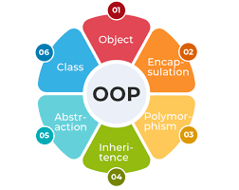

Slide 201
Classes and objects
Python is an object oriented programming language.
Almost everything in Python is an object, with its properties and methods.
A Class is like a "blueprint" for creating objects.

Slide 202
Create a class
To create a class, use the keyword class:
Example
Create a class named MyClass, with a property named x:
class MyClass: x = 5

Slide 203
Example:
class student:
name="abcd"
def display(self):🡪 default argument.
print("hello")
s=student() 🡪 object creation
s.display() 🡪 called to class method.
A class can have multiple objects.
We can change the value of an attribute using object.
The changes will not affect the another object.

Slide 204
Create object
Now we can use the class named MyClass to create objects:
Example
Create an object named p1, and print the value of x:
p1 = MyClass() print(p1.x)
Example:
class MyClass:
x = 5
a = MyClass()
print(a.x)
output:5

Slide 205
Problem 8
Create a Class with the attributes Name, Age and Place with respective values. Print the values of Age, Name and Place by using an Object.

Slide 206
constructor
A constructor is a special type of method (function) which is used to initialize the instance members of the class.
In C++ or Java, the constructor has the same name as its class, but it treats constructor differently in Python. It is used to create an object.
Constructors can be of two types.
1.Parameterized Constructor
2.Non-parameterized (Default) Constructor

Slide 207
Type 1:
class exam:
def __init__(self):
print("hai")
s=exam()
Type 2:
class rectangle:
def __init__(self,L,B):
print("area:",L*B)
r=rectangle(5,10)

Slide 208
Creating the Constructor in Python
In Python, the method the __init__() simulates the constructor of the class. This method is called when the class is instantiated. It accepts the self-keyword as a first argument which allows accessing the attributes or method of the class.

Slide 209
The self parameter
The self parameter is a reference to the current instance of the class, and is used to access variables that belongs to the class.
It does not have to be named self , you can call it whatever you like, but it has to be the first parameter of any function in the class:

Slide 210
Example:
class Person:
def __init__(self, name, age):
a.name = name
a .age = age
def myfunc(a):
print("Hello my name is "+ abc.name,abc.age)
p = Person("John",36)
p.myfunc()
output: Hello my name is John 36

Slide 211
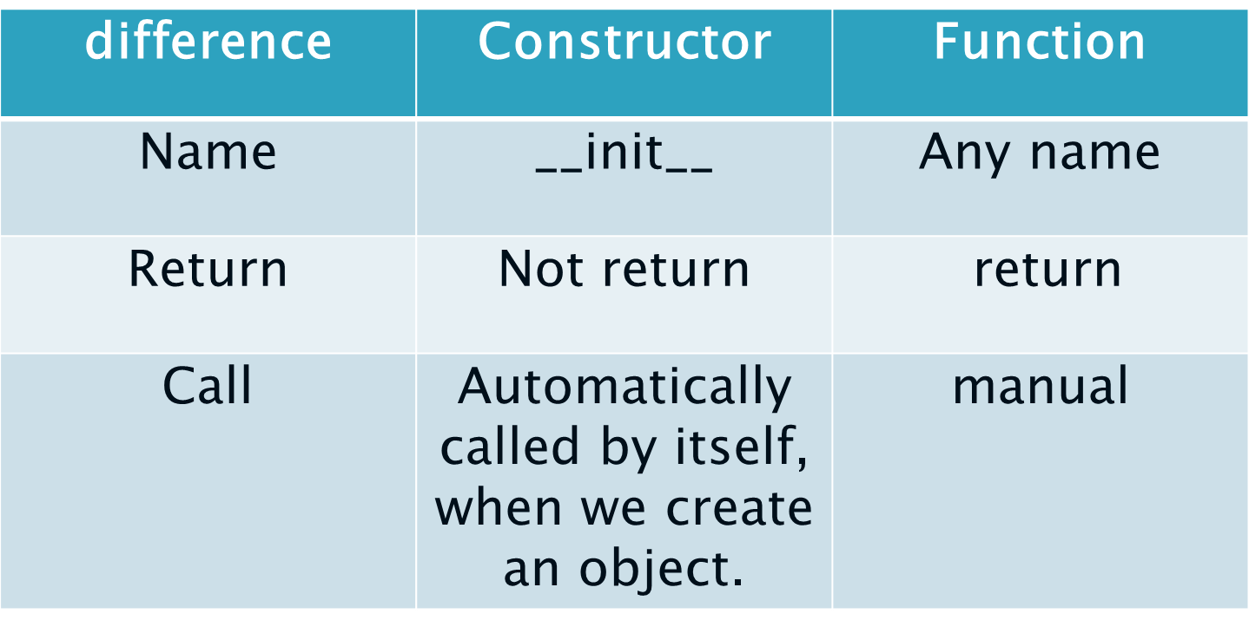

Slide 212
inheritance:
Inheritance allows us to define a class that inherits all the methods and properties from another class.
A class which gives its properties 🡪parent/super/base class.
A class which gets properties from another 🡪 child/sub/derived class.

Slide 213
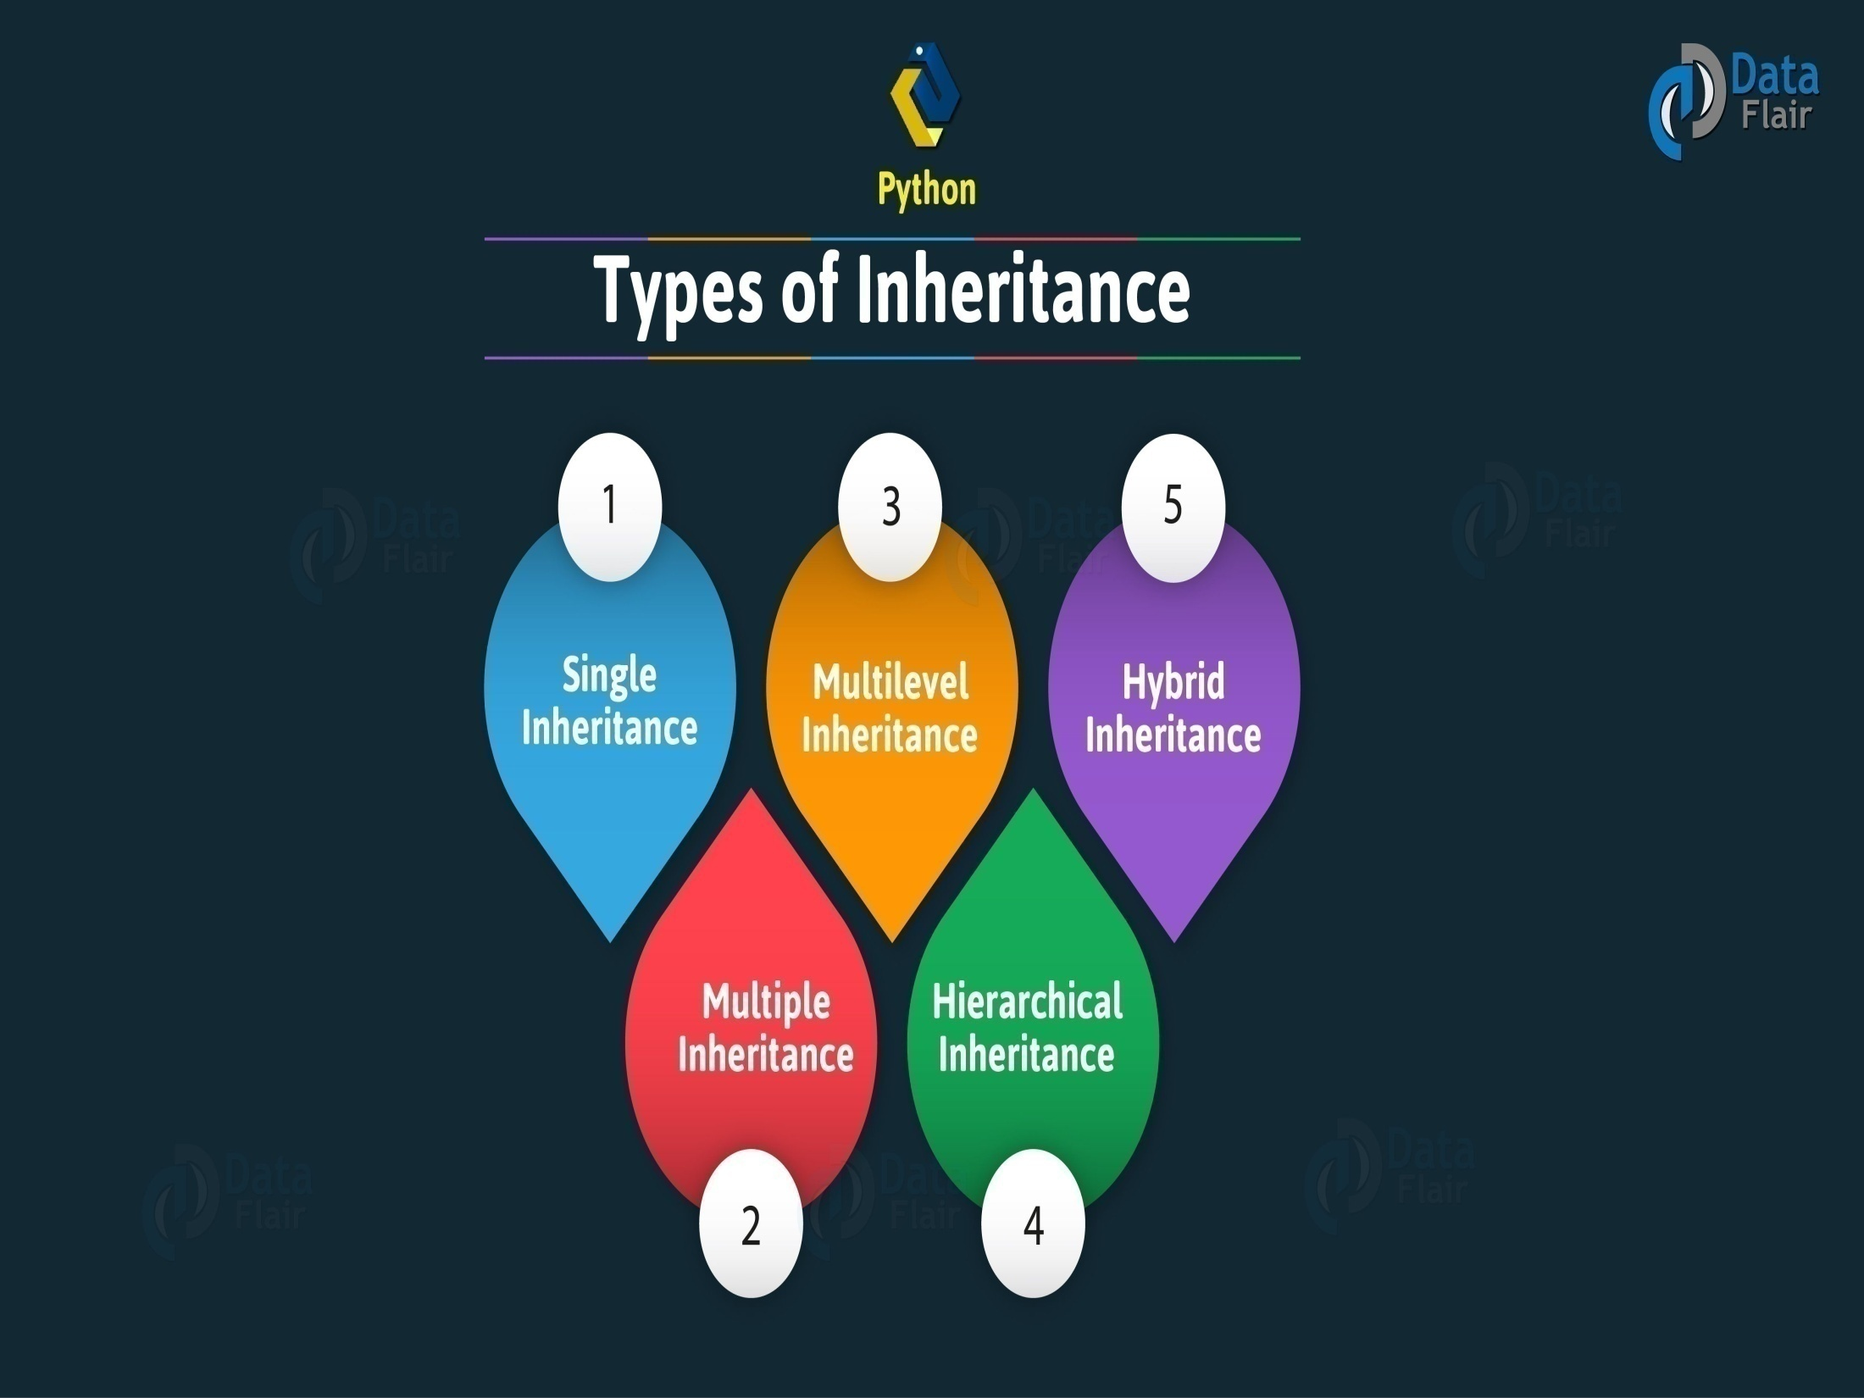

Slide 214
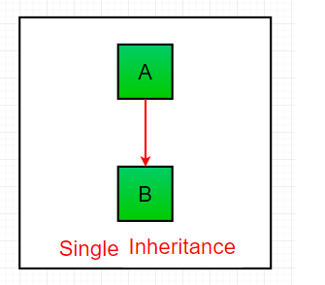
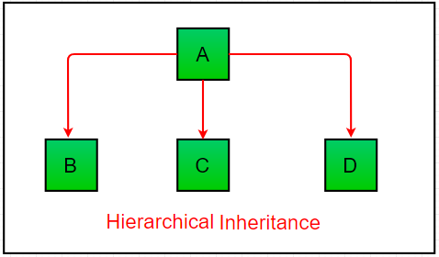
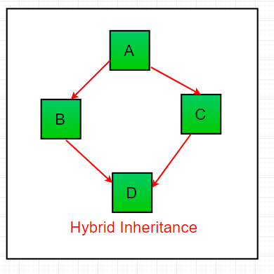
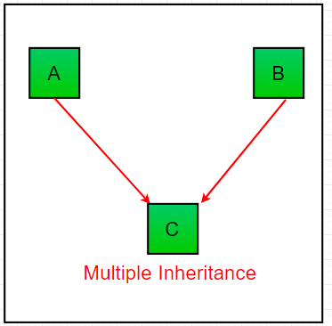
A
B
C
Multi-level Inheritance
Python Inheritance

Slide 215


Slide 216
Example:
class A:
def __init__(self,pi,r):
self.pi=pi
self.r=r
def circum(self):
print('circumference:',2*self.pi*self.r)
def area(self):
print('Area:',self.pi*self.r**2)
a=A(3.45,8)
a.circum()
a.area()
output:
circumference: 55.2
Area: 220.8

Slide 217
Type 1:
class A:
a=10
class B(A):
b=20
b=B()
print(b.a,b.b)
Type 2:
class A:
a=10
class B(A):
b=20
class C(B):
c=30
c=C()
print(c.a,c.b,c.c)
Type 3
class A:
a=10
class B(A):
b=20
class C(A):
c=30
b=B()
c=C()
print(b.a,b.b,c.a,c.c)
Type 4
class A:
a=10
class B:
b=20
class C(A,B):
c=30
c=C()
print(c.a,c.b,c.c)
Type 5
class A:
a=10
class B:
b=20
class C(A,B):
c=30
class D(C):
d=40
d=D()
print(d.a,d.b,d.c,d.d)

Slide 218
Example:
single inherit:
class dad():
def phone(self):
print("Dad's phone")
class son():
def laptop(self):
print("son's laptop")
s=son()
s.laptop()
(or) class son(dad)
s.phone()
class fruit():
def pineapple(self):
print("My favorite fruit is pineapple")
class vegetable(fruit):
def betroot(self):
print("my favorite vegetables is betroot")
me=vegetable()
me.betroot()
me.pineapple()

Slide 219
Mulitilevel:
class fruit():
def pineapple(self):
print("My favorite fruit is pineapple")
class vegetable(fruit):
def betroot(self):
print("my favorite vegetables is betroot")
class color(vegetable):
def pink(self):
print("my favorite color is pink")
me=color()
me.pink()
me.betroot()
me.pineapple()
o/p:
my favorite color is pink
my favorite vegetables is betroot
My favorite fruit is pineapple

Slide 220
Hierarchical :
class fruit():
def pineapple(self):
print("My favorite fruit is pineapple")
class vegetable(fruit):
def betroot(self):
print("my favorite vegetables is betroot")
class color(fruit):
def pink(self):
print("my favorite color is pink")
me=vegetable()
am=color()
me.pineapple()
me.betroot()
am.pineapple()
am.pink()
o/p:
My favorite fruit is pineapple
my favorite vegetables is betroot
My favorite fruit is pineapple
my favorite color is pink

Slide 221
Polymorphism:
The word polymorphism means having many forms. In programming, polymorphism means the same function name (but different signatures) being used for different types.
Example;
def add(a,b,c=0):
print(a+b+c)
add(1,2)
add(1,2,4)
o/p:
3
7

Slide 222
Example:
class India():
def capital(self):
print("New Delhi is the capital of India.")
def language(self):
print("Hindi is the most widely spoken language of India.")
def type(self):
print("India is a developing country.")
class USA():
def capital(self):
print("Washington, D.C. is the capital of USA.")
def language(self):
print("English is the primary language of USA.")
def type(self):
print("USA is a developed country.")
ind = India()
usa = USA()
for c in (ind,usa):
c.capital()
c.language()
c.type()

Slide 223
The Super() function
Python also has a super() function that will make the child class inherit all the methods and properties from its parent:
class Student(Person): def __init__(self, fname, lname): super().__init__(fname, lname)

Slide 224
Example:
constructor
class a():
def __init__(self):
print("A")
def display(self):
print("you are in class a")
class b():
def display(self):
print("you are in class b")
ob=a() object
o/p: A
class a():
def __init__(self):
print("A")
def display(self):
print("you are in class a")
class b(a):
def display(self):
print("you are in class b")
ob=b()
o/p: A

Slide 225
class a():
def __init__(self):
print("A")
def display(self):
print("you are in class a")
class b(a):
def __init__(self):
#super().__init__()
print("B")
def display(self):
print("you are in class b")
ob=b()
o/p: B
class a():
def __init__(self):
print("A")
def display(self):
print("you are in class a")
class b(a):
def __init__(self):
super().__init__()
print("B")
def display(self):
print("you are in class b")
ob=b()
ob.display()
o/p: A
B

Slide 226
Add the init() function
Note: The __init__() function is called automatically every time the class is being used to create a new object.
Add the __init__() function to the Student class:
class Student(Person): def __init__(self, fname, lname): Person.__init__(self, fname, lname)

Slide 227
Add properties
class Student(Person): def __init__(self, fname, lname): super().__init__(fname, lname) self.graduationyear = 2019
x = Student("Mike", "Olsen", 2019)

Slide 228
Add methods
def __init__(self, fname, lname, year): super().__init__(fname, lname) self.graduationyear = year def welcome(self): print("Welcome", self.firstname, self.lastname, "to the class of", self.graduationyear)

Slide 229
Ex:
class a():
def __init__(self):
print("A")
def display(self):
print("you are in class a")
class b():
def __init__(self):
super().__init__()
print("B")
def display(self):
print("you are in class b")
class c(b,a):
def __init__(self):
super().__init__()
print("c")
def display(self):
print("you are in class c")
ob=c()
o/p:
A
B
C

Slide 230

Overloading:
Overloading is defining two or more methods with the same name but different parameters. Python does not support method overloading. The super() function and mutiple dispatch module is used to avoid overriding.
Overriding:
Overriding is redefining a parent class method in the derived class. Overriding requires inheritance for implementation.

Slide 231


Slide 232
Example: (method overriding)
class sample:
def hello(self):
print('hello')
def hello(self):
print('welcome')
class copy(sample):
def hello(self):
print('hai')
s=sample()
s.hello()
c=copy()
c.hello()
o/p:
welcome
hai
class sample:
def hello(self):
print('hello')
def hello(self):
print('welcome')
def hello(self):
print('to livewire')
class copy(sample):
def hello(self):
print('hai')
s=sample()
s.hello()
c=copy()
c.hello()
output: to livewire
hai

Slide 233
method overloading:
def product(a,b):
p=a*b
print(p)
def product(a,b,c):
p=a*b*c
print(p)
def product(a,b,c,d):
p=a*b*c+d
print(p)
product(3,2)
product(4,5,6)
product(4,5,6,1)

Slide 234
Problem 10
Give a simple example of Single, Hierarchical and Multi-Level Inheritance

Slide 235
encapsulation
Encapsulation in Python is the process of wrapping up variables and methods into a single entity. In programming, a class is an example that wraps all the variables and methods defined inside it.
It can be used for password protection

Slide 236
Private members
If we declare any variable or method as private, then they can be accessed only within the class in which they are defined. In Python, private members are preceded by two underscores
Example:
private(__variable name)
getter 🡪used to return the value stored in private
setter 🡪used to set value in private variable.

Slide 237
Protected members
Protected members can be accessed within the class in which they are defined and also within the derived classes. In Python, protected members are preceded by a single underscore.
Example:
protected(_variable name)

Slide 238
Type 1:
class encap:
_username='livewire'
__password='hello123'
def test(self):
print(self._username,self.__password)
e=encap()
e.test()
class display(encap):
def check(self):
print(self._username)
print(self.__password)
d=display()
d.check()
o/p:
livewire
hello123

Slide 239
Type 2:
class encap:
__username=0
__password=0
def setusername(self,un):
self.__username=un
def getusername(self):
print(self.__username)
def setpassword(self,pw):
self.__password=pw
def getpassword(self):
print(self.__password)
e=encap()
e.setusername('mounika')
e.getusername()
e.setpassword('5457698')
e.getpassword()

Slide 240
Abstraction
Abstraction is used to hide the internal functionality of the function from the users. The users only interact with the basic implementation of the function, but inner working is hidden. User is familiar with that "what function does" but they don't know "how it does.“
In Python, an abstraction is used to hide the irrelevant data/class in order to reduce the complexity. It also enhances the application efficiency.

Slide 241
Used to hide data (or) process.
Which method have only declaration and not have definition called abstraction.
Rules:
The object does not create in abstraction class.
We can use the properties of an abstract with the help of child class.
The child class should override the abstract method present in abstract class.
In the abstract methods, the self parameter is optional.
The abstract class inherit the built in class(ABC).

Slide 242
from abc import ABC,abstractmethod
class abstract(ABC):
name='mounika'
@abstractmethod
def sample(self):
pass
class display(abstract):
def sample(self):
print(self.name)
d=display()
d.sample()
o/p:
mounika

Slide 243
Example:
from abc import ABC, abstractmethod
class Car(ABC):
def mileage(self):
pass
class Tesla(Car):
def mileage(self):
print("The mileage is 30kmph")
class Suzuki(Car):
def mileage(self):
print("The mileage is 25kmph ")
class Duster(Car):
def mileage(self):
print("The mileage is 24kmph ")
class Renault(Car):
def mileage(self):
print("The mileage is 27kmph ")
# Driver code
t= Tesla ()
t.mileage()
r = Renault()
r.mileage()
s = Suzuki()
s.mileage()
d = Duster()
d.mileage()

Slide 244
t=Triangle()
t.sides()
s=square()
s.sides()
p=Pentagon()
p.sides()
k=Hexagon()
k.sides()
output:
?
from abc import ABC
class Polygon(ABC):
# abstract method
def sides(self):
pass
class Triangle(Polygon):
def sides(self):
print("Triangle has 3 sides")
class Pentagon(Polygon):
def sides(self):
print("Pentagon has 5 sides")
class Hexagon(Polygon):
def sides(self):
print("Hexagon has 6 sides")
class square(Polygon):
def sides(self):
print("I have 4 sides")

Slide 245
Built in class functions
SN | Function | Description
1 | getattr(obj,name,default) | It is used to access the attribute of the object.
2 | setattr(obj, name,value) | It is used to set a particular value to the specific attribute of an object.
3 | delattr(obj, name) | It is used to delete a specific attribute.
4 | hasattr(obj, name) | It returns true if the object contains some specific attribute.

Slide 246
Built in class attributes
SN | Attribute | Description
1 | __dict__ | It provides the dictionary containing the information about the class namespace.
2 | __doc__ | It contains a string which has the class documentation
3 | __class__ | It is used to access the class name.
4 | __module__ | It is used to access the module in which, this class is defined.
5 | __bases__ | It contains a tuple including all base classes.

Slide 247
MODULES AND PACKAGES

Slide 248


Slide 249
Modules
Module : A python module can be defined as a python program file which contains a python code including python functions, class, or variables. In other words, we can say that our python code file saved with the extension (.py) is treated as the module.
We need to load the module in our python code to use its functionality. Python provides two types of statements as defined below.
The import statement
The from-import statement

Slide 250
INBUILT MODULE: MATH MODULE
Example:
1st Method: import math
2nd Method: From import math *
3rd Method: From math import sqrt
4th Method: Import math as m

Slide 251
Example:
import math
Print(math.pi)
Print(math.factorial(6))
Print(math.pow(5,2)
from math import *
Print(sin(65))
Print(cos(67))
from math import sqrt,cbrt
Print(sqrt(88))
import math as m
Print(m.ceil(56.235686)
Print(m.floor(56.888)
Print(m.cbrt(64))

Slide 252
Modules:
In Python, a module is a file that contains Python definitions and statements.
The file name is the module name with the ".py" extension at the end.
Modules can be imported into other Python codes and provide functions, classes, and other functional codes that can be reused in multiple places.
1. math - provides mathematical functions like sqrt()(for finding square root of a number), sin()(for finding sin of an angle), cos()(for finding cos of an angle), etc.
Example:
import math
x = math.sqrt(16)
print("Square root of 16 is:",x)
output:?

Slide 253
2. random - provides tools for generating random numbers, shuffling sequences, and selecting random items.
Example:
import random
number=[1,2,3,4,5,6,7]
print(random.choice(number))
output:?
3. random.randint()-used to generate random integers between the given range
Example:
import random
number = random.randint(1, 10)
print("A random number between 1 and 10 is:",number)
output:?

Slide 254



Slide 255
Python math
Python has a set of built-in math functions, including an extensive math module, that allows you to perform mathematical tasks on numbers.

Slide 256



Slide 257
#in built modules #math function
import math
print(math.pi)
print(math.sin(89))
import math as m
print(m.cos(33))
print(m.tan(43))
from math import sqrt,cbrt,sin
print(sqrt(34))
print(cbrt(34))
print(sin(34))
from math import *
print(factorial(5))
print(gcd(21,45))

Slide 258
Built-in Math Functions
The min() and max() functions can be used to find the lowest or highest value in an iterable:
Example
x = min(5, 10, 25) y = max(5, 10, 25) print(x) print(y)
output:
5
25

Slide 259
x = abs(-7.25) →absolute if the value is negative it return the value positive other wise if the value is positive unchanged print(x)
x = pow(4, 3) print(x)

Slide 260
Math module
Python has also a built-in module called math, which extends the list of mathematical functions.
To use it, you must import the math module:
import math

Slide 261
………
import math x = math.ceil(1.4) y = math.floor(1.4) print(x) # returns 2 print(y) # returns 1 x = math.sqrt(64) print(x)
x = math.pi print(x)

Slide 262
Python modules
Consider a module to be the same as a code library.
A file containing a set of functions you want to include in your application.
Create a module
Save this code in a file named mymodule.py
def greeting(name): print("Hello, " + name)

Slide 263
Use a Module
Import the module named mymodule, and call the greeting function:
import mymodule mymodule.greeting("Jonathan")
Example:
import day11
def gre(name):
print("Hello, "+name)
day11.gre("Jonathan")

Slide 264
Variables in module
The module can contain functions, as already described, but also variables of all types (arrays, dictionaries, objects etc):
Save this code in the file mymodule.py
person1={ "name": "John", "age": 36,"country": "Norway"}

Slide 265
Import the module named mymodule, and access the person1 dictionary:
Example:
import day11
person1={"name":"John","age":36,"country":"Norway"}
a=day11.person1["age"]
print(a)

Slide 266
Re naming a module
Create an alias for mymodule called mx:
import mymodule as mx a = mx.person1["age"] print(a)
Example:
import day11 as module
person1={"name":"John","age":36,"country":"Norway"}
a=module.person1["age"]
print(a)

Slide 267
Python date time
Import the datetime module and display the current date:
from datetime import datetime
x=datetime.now() or datetime.today()
print(x)
from datetime import datetime
x=datetime(2023,12,30,11,6,32,5)
print(x)
from datetime import datetime
x=datetime(2023,12,30)
print(x)

Slide 268
from datetime import datetime
x=datetime.now()
print("Day:",x.day)
print("Month:",x.month)
print("Year:",x.year)
print("Hour:",x.hour)
print("Minute:",x.minute)
print("Second:",x.second)
import time
x=time.time()
print(time.ctime(x))

Slide 269
from datetime import *
d=datetime.now()
print(d)
print(d.date())
print(d.day,d.month,d.year)
print(d.time())
from datetime import date
today=date.today()
print(today.year)
print(today.month)
print(today.day)

Slide 270
The strftime() method
Strf()→String format time function used to convert date and time objects to their string representation.
import datetime x = datetime.datetime.now() print(x.year) print(x.strftime("%A"))
print(x.strftime(“%a”))
print(x.strftime(“%y”))
print(x.strftime(“%c”))

Slide 271
Directive | Description | Example
%a | Weekday, short version | Wed
%A | Weekday, full version | Wednesday
%w | Weekday as a number 0-6, 0 is Sunday | 3
%d | Day of month 01-31 | 31
%b | Month name, short version | Dec
%B | Month name, full version | December
%m | Month as a number 01-12 | 12
%y | Year, short version, without century | 18
%Y | Year, full version | 2018
%H | Hour 00-23 | 17
%I | Hour 00-12 | 05
%p | AM/PM | PM
%M | Minute 00-59 | 41
%S | Second 00-59 | 08
%f | Microsecond 000000-999999 | 548513
%z | UTC offset | +0100
%Z | Timezone | CST
%j | Day number of year 001-366 | 365
%U | Week number of year, Sunday as the first day of week, 00-53 | 52
%W | Week number of year, Monday as the first day of week, 00-53 | 52
%c | Local version of date and time | Mon Dec 31 17:41:00 2018
%x | Local version of date | 12/31/18
%X | Local version of time | 17:41:00
%% | A % character | %

Slide 272
Sleep time
The sleep() method of time module is used to stop the execution of the script for a given amount of time. The output will be delayed for the number of seconds provided as the float.
Ex:
from time import*
for i in range(0,5):
print(i)
sleep(1)
from time import *
sleep(2)
print(ctime())

Slide 273
The calendar module
Python provides a calendar object that contains various methods to work with the calendars.
Ex:
import calendar
cal = calendar.month(2020,3)
print(cal)

Slide 274
Printing the calendar of whole year
The prcal() method of calendar module is used to print the calendar of the entire year. The year of which the calendar is to be printed must be passed into this method.
Ex:
from calendar import*
print(prcal(2024))
print(month(2024,3))

Slide 275
Random number
Python does not have a random() function to make a random number, but Python has a built-in module called random that can be used to make random numbers:
Example
Import the random module, and display a random number between 1 and 9:
import random print(random.randrange(1, 10))

Slide 276
Random Module
The Python random module functions depend on a pseudo-random number generator function random(), which generates the float number between 0.0 and 1.0.
SNO | Function | Description
1 | choice() | This function returns a randomly selected element from a non-empty sequence.
2 | shuffle() | This function randomly reorders the elements in the list.
3 | randrange() | Returns a random number between the given range
4 | randint() | Returns a random number between the given range
5 | random() | Returns a random float number between 0 and 1

Slide 277
Example:
import random
print(random.random())
print(random.randint(1,10))
print(random.randrange(10))
print(random.randrange(2,10))
print(random.random(10,100,10))

Slide 278
from random import *
print(random())
print(randint(1,10))
print(randrange(10,20,3))
print(uniform(10,50))→The uniform() method returns a random floating number between the two specified numbers (both included).
li=[34,6,7,4,43,89,46]
print(choice(li))
print(choices(li,k=2))
shuffle(li)
print(li)

Slide 279
Sample()→sample() is an inbuilt function of random module in Python that returns a particular length list of items chosen from the sequence
i.e. list, tuple, string or set. Used for random sampling without replacement.
Ex:
li=[34,6,7,4,43,89,46]
print(sample(li,k=4))
from random import sample
list1 = [1, 2, 3, 4, 5]
print(sample(list1,3))

Slide 280
choice()→The choice() method returns a randomly selected element from the specified sequence.
The sequence can be a string, a range, a list, a tuple or any other kind of sequence.
Ex:
import random mylist = ["apple", "banana", "cherry"] print(random.choice(mylist))
import random
x = "WELCOME"
print(random.choice(x))

Slide 281
User Module:
Used to call existing file as module.
File name have some rules,
Not start with space and special characters
(except _)
Not be a preserved keywords.
How to use?
Create a new file
Import a existing file name as a module
Ex(from text import *)
Call the methods and classes
Use the preserved variable of data/values.
(Note:Both files in same Directory.)

Slide 282
FILE HANDLING

Slide 283
File handling
The key function for working with files in Python is the open() function.
The open() function takes two parameters; filename, and mode.
Used to read ,write the existing files.
open() is a function used to open the existing file.
Open(filepath,mode)
MODE:
x(create)
w(write)
r(read)
a(append)

Slide 284
Modes of opening file
"r" - Read - Default value. Opens a file for reading, error if the file does not exist
"a" - Append - Opens a file for appending, creates the file if it does not exist
"w" - Write - Opens a file for writing, creates the file if it does not exist
"x" - Create - Creates the specified file, returns an error if the file exists

Slide 285
…………
In addition you can specify if the file should be handled as binary or text mode
"t" - Text - Default value. Text mode
"b" - Binary - Binary mode (e.g. images)
Syntax
To open a file for reading it is enough to specify the name of the file:
f = open("demofile.txt")

Slide 286
Create Mode(x):
It will create a file in given location.
If file name is already exists, then error will occur.
Copy the path from where the file to be stored.
Create a file name with extension(.py,.jpg…)
using \\to file path.
Example;
file=open("C:\\Users\\LIVEWIRE\\Desktop\\ kalai\\test4.py","x")

Slide 287
Python file open
f = open("demofile.txt", "r") print(f.read())
Read mode(r);
Example:
file=open("C:\\Users\\LIVEWIRE\\Desktop\\ kalai\\test4.py","r")
Print(file.read()) #it read full file
Print(file.read(5)) #it read first 5 letters of file
Print(file.readline()) # it read first line of file

Slide 288
Read only parts of the file
f = open("demofile.txt", "r") print(f.read(5))
Read Lines
f = open("demofile.txt", "r") print(f.readline())

Slide 289
Close file
f = open("demofile.txt", "r") print(f.readline()) f.close()

Slide 290
Python file write
To write to an existing file, you must add a parameter to the open() function:
"a" - Append - will append to the end of the file
"w" - Write - will overwrite any existing content
Write mode(w):
Write mode only rewrite the contents.
That means, it rub already written contents in file and store new content which is given by us.

Slide 291
If the file name is not existing, it create new file and write.
Example:
file=open("C:\\Users\\LIVEWIRE\\Desktop\\ kalai\\welcome.doc","w")
file.write("welcome to livewire")
file.close()

Slide 292
APPEND METHOD:
Used to add the content with existing one.
If the file name is not existing it create new file and add the new data's.
Example:
file=open("C:\\Users\\LIVEWIRE\\Desktop\\kalai\\welcome.doc","a")
file.write("\n NAME: LIVEWIRE")
file.close()

Slide 293
f = open("demofile2.txt", "a") f.write("Now the file has more content!") f.close() #open and read the file after the appending: f = open("demofile2.txt", "r") print(f.read())

Slide 294
Write method
f = open("demofile3.txt", "w") f.write("oops! I have deleted the content!") f.close() #open and read the file after the writing: f = open("demofile3.txt", "r") print(f.read())

Slide 295
Create a new file
"x" - Create - will create a file, returns an error if the file exist
"a" - Append - will create a file if the specified file does not exist
"w" - Write - will create a file if the specified file does not exist
f = open("myfile.txt", "x")
f = open("myfile.txt", "w")

Slide 296
MODULE OS:
Check if the file is exists or not and return True or False
import os
print(os.path.exists('E:\\CRanjani\\mounika.txt‘))
Output:
True →when the file was exist.
import os
print(os.path.exists(‘E:\\CRanjani\\mounikaa.txt‘))
Output:
False →when the file was not exist.

Slide 297
Deleting the File:
It remove the file permanently from system.
Example1:
Import os:
os.remove(("C:\\Users\\LIVEWIRE\\Desktop\\kalai\\test4.py")
Example2:
Removing the directory or folder:
It removes empty folder only
Import os
Os.rmdir(C:\\Users\\LIVEWIRE\\Desktop\\kalai
\\sample”)

Slide 298
Python delete file
To delete a file, you must import the OS module, and run its os.remove() function:
Example
Remove the file "demofile.txt":
import os os.remove("demofile.txt")
import os
os.remove('E:\\CRanjani\\mounika.txt')

Slide 299
Check if the file exist
Example:
import os if os.path.exists("demofile.txt"): os.remove("demofile.txt") else: print("The file does not exist")

Slide 300
Delete folder
To delete an entire folder, use the os.rmdir() method:
Example
Remove the folder "myfolder":
import os os.rmdir("myfolder")
Note: You can only remove empty folders.

Slide 301

Exception Handling

Slide 302
Exception handling:
Error in Python can be of two types i.e. Syntax errors and Exceptions. Errors are problems in a program due to which the program will stop the execution.
On the other hand, exceptions are raised when some internal events occur which change the normal flow of the program.
Used to handle the unexpected errors which means run time errors occurred when the user give wrong inputs.

Slide 303
Type of Errors:
Compile time error(syntax error)
Logical Error (wrong output)
Run time Error
Types of Run time Errors:
Name Error: wrong variable declaration.
Type Error: using invalid data types and operation.

Slide 304


Example:

Slide 305
iii)Value Error: wrong input get from user.
iv)Index Error: wrong index given. It occurred in list,tuple,set data types.
v) Zero DivisionError: when the error occur in the divide function, the user give divider value for 0.
vi)Attribute Error: When using non-existing methods.
vii)Key Error: Wrong key word used in dictionary data type.
viii)File not Found Error: When we try to read non-existing file. When we try to create new file is same as existing file name.(module os)

Slide 306



Slide 307



Slide 308



Slide 309



Slide 310
ix)Recursion Error: When we try to write infinite recursion function.
x)OS Error: when we try to remove the non-empty folder using rmdir method.
xi)Permission Error: Wrong method used in OS module.
xii)Module Not Found: when we write module name.
xiii)Not A Directory Error: when we try to remove file using rmdir method

Slide 311
Recursion Limit Set:
We can set the limit for Recursion temporarily.
The value for Recursion limit is approximate only, not exacted.
import sys module
sys.getrecursionlimit() → used to get the limit value for Recursion
sys.setrecursionlimit(value) →used to set the limit value for Recursion.

Slide 312

Example:

Slide 313

Example:

Slide 314

Example:

Slide 315


Slide 316

o/p:
Error: cannot add an int and a str

Slide 317
Exception Handling:
Try Block: To detect and Monitor Error.
Except Block: To catch the Errors and give alternate solutions.
Finally Block:(optional)
Raise Keyword: To create own error.
Assert Keyword: To create own error but with a condition. This error occur when the condition is false.
ex:
if y==0:
raise ValueError("Error")
assert y!=0,"Error"

Slide 318
Example:
try:
a=int(input('Enter number:'))
b=int(input('Enter number:'))
'''if a==0:
raise ZeroDivisionError'''
assert a!=0,'Error‘
print('The division of given value is:',a/b)
except ValueError:
print('do not enter decimal values and characters')
except ZeroDivisionError:
print('Do not enter second values as zero')
except AssertionError:
print('Don not enter first value as zero')
finally:
print('Thank you')

Slide 319

Exception Handling

Slide 320

Iterator
An iterator is an object that contains a countable number of values.
used to read value one by one.
Methods of Iterator is iter() , next()

Slide 321
Example:
class MyNumbers:
def __iter__(self):
self.a = 1
return self
def __next__(self):
x = self.a
self.a += 1
return x
a = MyNumbers()
myiter = iter(a)
print(next(myiter))
print(next(myiter))
print(next(myiter))
print(next(myiter))
print(next(myiter))
li=[45,89,46,90,57]
a=iter(li)
print(next(a))
print(next(a))
print(a.__next__())
o/p:
45
89
46
my= "banana" m = iter(my) print(next(m)) print(next(m)) print(next(m)) print(next(m)) print(next(m)) print(next(m))
o/p:
b
a
n
a
n
a
o/p:
1
2
3
4
5

Slide 322
class MyNumbers:
def __iter__(self):
self.a = 1
return self
def __next__(self):
if self.a <= 20:
x = self.a
self.a += 1
return x
else:
raise StopIteration
myclass = MyNumbers()
b = iter(myclass)
for x in b:
print(x)
o/p: ?

Slide 323

Generator

Slide 324
Generators:
It create special iterator inside a function.
A generator-function is defined like a normal function, but whenever it needs to generate a value, it does so with the yield keyword rather than return.
If the body of a def contains yield, the function automatically becomes a generator function.
suppose we have to generate 100 values it’s hard to retrieve the function that ,we can generator for specific values.
It take more memory space to avoid use generator

Slide 325

Example:

Slide 326



Slide 327

Example 2:

Slide 328
Decorators:
It allows programmers to modify the behaviour of a function or class. [not changing the function]
Used for function rename purpose.
we can pass one function as argument to another function is called decorators.
In that way we can able to access both main function and sub function

Slide 329
To rename functon:
a=10
b=a
def sampleprogram():
print('sample')
sam=sampleprogram
sam()
t=sam
d=t
d()
d=s
s()
output: sample

Slide 330
To call inside a function
def fun(add):
def call():
print("welcome to livewire")
add(34+56)
print("happy learning")
return call()
fun(print)

Slide 331
Closure :
In python,you can define functions within functions i.e. nested. Python Closures are these inner functions enclosed within the outer function.
Function called inside a function.
A function defined inside another function is called a nested function. Nested functions can access variables of the enclosing scope.
This technique by which some data gets attached to the code is called closure in Python.

Slide 332
Ex:
def add():
a=21
def mul():
print(a*5)
print(a*45*6)
return mul()
add()
we can pass parameter inside a function.
def add(a):
def mul():
print(a*5)
print(a*45*6)
return mul()
add(21)
def fun():
a="hello"
def call():
print("welcome to livewire")
print(a)
print("happy learning")
return call()
fun()

Slide 333
def fun(a):
def call():
print("welcome to livewire")
print(a)
print("happy learning")
return call()
fun("hello")
def outer(a,b):
def inner():
print(a+b)
inner()
outer(34,78)

Slide 334
Multi-Threading
Any application can have multiple processes. Each of this process can be assigned either as a single thread or multiple threads.
Multithreaded applications execute two or more threads run concurrently.
Any application can have multiple processes. Each of this process can be assigned either as a single thread or multiple threads.
To run multi functions simultaneously.
Used in Network process.

Slide 335
Example: (without thread)
def run():
for i in range(1,6):
print('Class A')
def r():
for i in range(1,6):
print('Class B')
run()
r()
output:
Class A
Class A
Class A
Class A
Class A
Class B
Class B
Class B
Class B
Class B

Slide 336
with threading:
from threading import Thread
from time import sleep
class A(Thread):
def run(self):
for i in range(1,6):
print('Class A')
sleep(1)
class B(Thread):
def run(self):
for i in range(1,6):
print('Class B')
sleep(1)
a=A()
b=B()
a.start()
sleep(0.5)
b.start()
a.join()
b.join()
print('bye')
output:
Class A
Class B
Class A
Class B
Class A
Class B
Class A
Class B
Class A
Class B
bye

Slide 337
Python Tkinter
Python provides the standard library Tkinter for creating the graphical user interface for desktop based applications.
Developing desktop based applications with python Tkinter is not a complex task.

Slide 338
………..
An empty Tkinter top-level window can be created by using the following steps.
import the Tkinter module.
Create the main application window.
Add the widgets like labels, buttons, frames, etc. to the window.
Call the main event loop so that the actions can take place on the user's computer screen.

Slide 339
Window Creation:
import tkinter 🡪 import module.
x=t.kinter.Tk() 🡪 empty window creation.
x.Geometry(“width x height”) 🡪 resolution for window.
x.title(“title name “)🡪 specify the title name.
x.config() 🡪 mention background colour for window.

Slide 340

Example:
from tkinter import *
window=Tk()
window.geometry('500x500')
window.title('welcome to livewire')
window.config(bg='pink')

Slide 341

TKINTER ICON
from tkinter import *
window=Tk()
window.geometry('500x500')
window.title('welcome to livewire')
window.config(bg='pink')
window.iconbitmap('C:\\Users\\admin\\Desktop\\download.ico')

Slide 342
Tkinter widgets
Button
Label
Entry
Text
Checkbutton
RadioButton
Combobox
ListBox
Menu
Messagebox
Scrollbar
Scale
Spinbox
Icon
PanedWindow
LabelFrame
TopLevel

Slide 343
Python Tkinter Geometry
The Tkinter geometry specifies the method by using which, the widgets are represented on display. The python Tkinter provides the following geometry methods.
The pack() method
The grid() method
The place() method

Slide 344
pack():
The pack() widget is used to organize widget in the block. The positions widgets added to the python application using the pack() method can be controlled by using the various options specified in the method call.
Syntax:
W = Button(windows, options)
Tkinter widgets allow you to change two colors: foreground, meaning mainly the text and borders, and background, meaning the rest of the widget. These can be set using the foreground and background arguments, or their aliases fg and bg .

Slide 345
Button:
from tkinter import *
window=Tk()
window.geometry('500x500')
window.title('welcome to livewire')
window.config(bg='pink')
b1=Button(window,text='SUBMIT')
b1.pack()
b1=Button(window,text='SUBMIT')
b1.pack(side='right')
b1=Button(window,text='SUBMIT')
b1.pack(side='left')
b1=Button(window,text='SUBMIT')
b1.pack(side='bottom')

Slide 346


Slide 347
b1=Button(master=window,text='SUBMIT')
b1.pack(anchor=N)
b1=Button(master=window,text='SUBMIT')
b1.pack(anchor=S)
b1=Button(master=window,text='SUBMIT')
b1.pack(anchor=E)
b1=Button(master=window,text='SUBMIT')
b1.pack(anchor=W)

Slide 348


Slide 349
from tkinter import *
window=Tk()
window.geometry('500x500')
window.title('welcome to livewire')
window.config(bg='pink')
redbutton = Button(window, text = "Red", fg = "red")
redbutton.pack( side = LEFT)
greenbutton = Button(window, text = "Black", fg = "black")
greenbutton.pack( side = RIGHT )
bluebutton = Button(window, text = "Blue", fg= "blue")
bluebutton.pack( side = TOP )
blackbutton = Button(window, text = "Green", fg= "red")
blackbutton.pack( side = BOTTOM)

Slide 350

output:

Slide 351
Grid():
The grid() geometry manager organizes the widgets in the tabular form. We can specify the rows and columns as the options in the method call. We can also specify the column span (width) or rowspan(height) of a widget.
Syntax:
w=grid(window,options)

Slide 352
To create label:
from tkinter import *
window=Tk()
window.geometry('500x500')
window.title('welcome to livewire')
window.config(bg='pink')
name = Label(window,text = "Name").grid(row = 0, column = 0)
e1 = Entry(window).grid(row = 0, column = 1)
password = Label(window,text = "Password").grid(row = 1, column = 0)
e2 = Entry(window).grid(row = 1, column = 1)
mail_id = Label(window,text = "mail_id").grid(row = 2, column = 0)
e3 = Entry(window).grid(row = 2, column = 1)
submit = Button(window, text = "Submit").grid(row = 4, column = 0)

Slide 353

output:

Slide 354
using place():
from tkinter import *
window=Tk()
window.geometry('500x500')
window.title('welcome to livewire')
window.config(bg='pink')
name = Label(window, text = "Name").place(x = 30,y = 50)
email = Label(window, text = "Email").place(x = 30, y = 90)
password = Label(window, text = "Password").place(x = 30, y = 130)
username = Label(window, text = "username").place(x = 30, y = 160)
e1 = Entry(window).place(x = 80, y = 50)
e2 = Entry(window).place(x = 80, y = 90)
e3 = Entry(window).place(x = 95, y = 130)
e4 = Entry(window).place(x = 100, y = 160)

Slide 355

output:

Slide 356
Methods
S.No | Method | Description
1 | activebackground | It represents the background of the button when the mouse hover the button.
2 | activeforeground | It represents the font color of the button when the mouse hover the button.
3 | bg | It represents the background color of the button.
4 | fg | Foreground color of the button.
5 | font | The font of the button text.
6 | padx | Additional padding to the button in the horizontal direction.
7 | pady | Additional padding to the button in the vertical direction.
8 | Command | It is set to the function call which is scheduled when the function is called.
9 | bd | Size of the border around the corner.

Slide 357
Tkinter canvas
The canvas widget is used to add the structured graphics to the python application. It is used to draw the graph and plots to the python application.
Syntax
w = canvas(parent, options)

Slide 358

Example:
from tkinter import *
top = Tk()
top.geometry("200x200")
#creating a simple canvas
c = Canvas(top,bg = "pink",height = "500")
c.pack()

Slide 359
checkbutton
The Checkbutton is used to track the user's choices provided to the application. In other words, we can say that Checkbutton is used to implement the on/off selections.
The Checkbutton can contain the text or images.
Syntax
w = checkbutton(master, options)

Slide 360
Example:
from tkinter import *
top = Tk()
top.geometry("200x200")
checkvar1 = IntVar()
checkvar2 = IntVar()
checkvar3 = IntVar()
chkbtn1 = Checkbutton(top, text = "C", variable = checkvar1, onvalue = 1, offvalue = 0, height = 2, width = 10)
chkbtn2 = Checkbutton(top, text = "C++", variable = checkvar2, onvalue = 1, offvalue = 0, height = 2, width = 10)
chkbtn3 = Checkbutton(top, text = "Java", variable = checkvar3, onvalue = 1, offvalue = 0, height = 2, width = 10)
chkbtn1.pack()
chkbtn2.pack()
chkbtn3.pack()

Slide 361

output:

Slide 362
Methods
S.NO | Methods | Description
1 | variable | It represents the associated variable that tracks the state of the checkbutton.
2 | offvalue | The associated control variable is set to 0 by default if the button is unchecked. We can change the state of an unchecked variable to some other one.
3 | onvalue | The associated control variable is set to 1 by default if the button is checked. We can change the state of the checked variable to some other one.

Slide 363
Tkinter label
The Label is used to specify the container box where we can place the text or images. This widget is used to provide the message to the user about other widgets used in the python application.
The syntax to use the Label is given below.
Syntax
w = Label (master, options)

Slide 364
Tkinter entry
The Entry widget is used to provde the single line text-box to the user to accept a value from the user. We can use the Entry widget to accept the text strings from the user.
The syntax to use the Entry widget is given below.
Syntax
w = Entry (parent, options)

Slide 365
Example:
from tkinter import *
top = Tk()
top.geometry("400x250")
name = Label(top, text = "Name").place(x = 30,y = 50)
email = Label(top, text = "Email").place(x = 30, y = 90)
password = Label(top, text = "Password").place(x = 30, y = 130)
sbmitbtn = Button(top, text = "Submit",activebackground = "pink", activeforeground = "blue").place(x = 30, y = 170)
e1 = Entry(top).place(x = 80, y = 50)
e2 = Entry(top).place(x = 80, y = 90)
e3 = Entry(top).place(x = 95, y = 130)

Slide 366

output:

Slide 367
Tkinter frame
It is used to organize the group of widgets. It acts like a container which can be used to hold the other widgets.
The rectangular areas of the screen are used to organize the widgets to the python application.
Syntax
w = Frame(parent, options)

Slide 368
Example:
top = Tk()
top.geometry("140x100")
frame = Frame(top)
frame.pack()
leftframe = Frame(top)
leftframe.pack(side = LEFT)
rightframe = Frame(top)
rightframe.pack(side = RIGHT)
btn1 = Button(frame, text="Submit", fg="red",activebackground = "red")
btn1.pack(side = LEFT)
btn2 = Button(frame, text="Remove", fg="brown", activebackground = "brown")
btn2.pack(side = RIGHT)
btn3 = Button(rightframe, text="Add", fg="blue", activebackground = "blue")
btn3.pack(side = LEFT)
btn4 = Button(leftframe, text="Modify", fg="black", activebackground = "white")
btn4.pack(side = RIGHT)

Slide 369

output:

Slide 370
Tkinter listbox
The Listbox widget is used to display the list items to the user. We can place only text items in the Listbox and all text items contain the same font and color.
Syntax:
w = Listbox(parent, options)

Slide 371

Example:
from tkinter import *
top = Tk()
top.geometry("200x250")
lbl = Label(top,text = "A list of favourite countries...")
listbox = Listbox(top)
listbox.insert(1,"India")
listbox.insert(2, "USA")
listbox.insert(3, "Japan")
listbox.insert(4, "Austrelia")
lbl.pack()
listbox.pack()

Slide 372
To delete list:
from tkinter import *
top = Tk()
top.geometry("200x250")
lbl = Label(top,text = "A list of favourite countries...")
listbox = Listbox(top)
listbox.insert(1,"India")
listbox.insert(2, "USA")
listbox.insert(3, "Japan")
listbox.insert(4, "Austrelia")
btn = Button(top, text = "delete", command = lambda listbox=listbox: listbox.delete(ANCHOR))
lbl.pack()
listbox.pack()
btn.pack()

Slide 373

output:

Slide 374
Tkinter radio button
The Radiobutton widget is used to implement one-of-many selection in the python application.
It shows multiple choices to the user out of which, the user can select only one out of them.
Syntax
w = Radiobutton(top, options)

Slide 375
Example:
from tkinter import *
def selection():
selection = "You selected the option " + str(radio.get())
label.config(text = selection)
top = Tk()
top.geometry("500x500")
radio = IntVar()
lbl = Label(text = "Favourite programming language:")
lbl.pack()
R1 = Radiobutton(top, text="C",variable=radio,value=1,command=selection)
R1.pack( anchor = W )
R2 = Radiobutton(top, text="C++",variable=radio,value=2,command=selection)
R2.pack( anchor = W )
R3 = Radiobutton(top, text="Java",variable=radio,value=3,command=selection)
R3.pack( anchor = W)
label = Label(top)
label.pack()

Slide 376


Slide 377
Tkinter message
The Message widget is used to show the message to the user regarding the behaviour of the python application.
The message widget shows the text messages to the user which can not be edited.
Syntax
w = Message(parent, options)

Slide 378

Example:
from tkinter import *
top = Tk()
top.geometry("500x500")
var = StringVar()
msg = Message(top,text = "Welcome to livewire!!!",justify=CENTER)
msg.pack()

Slide 379
Tkinter menu
The Menu widget is used to create various types of menus (top level, pull down, and pop up) in the python application.
We need to create a new instance of the Menu widget and add various commands to it by using the add() method.
Syntax
w = Menu(top, options)

Slide 380
Menu options:
relief | This option specifies the type of the border. The default value is RAISED.
text | The text shown with the widget.
textvariable | We can set the control variable of string type to the text variable so that we can control the text of the widget at runtime.
menu | It represents the menu specified with the Menubutton.

Slide 381


Slide 382


Slide 383

Example:
from tkinter import *
top = Tk()
top.geometry("500x500")
menubutton = Menubutton(top, text = "File", relief = RAISED)
menubutton.grid()
menubutton.menu = Menu(menubutton)
menubutton["menu"]=menubutton.menu
menubutton.menu.add_checkbutton(label = "New File", variable = IntVar())
menubutton.menu.add_checkbutton(label = "save", variable=IntVar())
menubutton.menu.add_checkbutton(label = "open", variable = IntVar())
menubutton.menu.add_checkbutton(label = "save as", variable = IntVar())
menubutton.menu.add_checkbutton(label = "open", variable = IntVar())
menubutton.menu.add_checkbutton(label = "close window", variable = IntVar())
menubutton.pack()

Slide 384
from tkinter import Toplevel, Button, Tk, Menu
top = Tk()
top.geometry("500x500")
menubar = Menu(top)
file = Menu(menubar, tearoff=0)
file.add_command(label="New")
file.add_command(label="Open")
file.add_command(label="Save")
file.add_command(label="Save as...")
file.add_command(label="Close")
file.add_separator()
file.add_command(label="Exit", command=top.quit)
menubar.add_cascade(label="File", menu=file)
edit = Menu(menubar, tearoff=0)
edit.add_command(label="Undo")
edit.add_separator()
edit.add_command(label="Cut")
edit.add_command(label="Copy")
edit.add_command(label="Paste")
edit.add_command(label="Delete")
edit.add_command(label="Select All")
menubar.add_cascade(label="Edit", menu=edit)
help = Menu(menubar, tearoff=0)
help.add_command(label="About")
menubar.add_cascade(label="Help", menu=help)
top.config(menu=menubar)

Slide 385


Slide 386
Python Tkinter Scale
The Scale widget is used to implement the graphical slider to the python application so that the user can slide through the range of values shown on the slider and select the one among them.
We can control the minimum and maximum values along with the resolution of the scale. It provides an alternative to the Entry widget when the user is forced to select only one value from the given range of values.
Syntax:
w = Scale(top, options)

Slide 387


Slide 388


Slide 389

Example:
from tkinter import *
def select():
sel = "Value = " + str(v.get())
label.config(text = sel)
top = Tk()
top.geometry("500x500")
v = DoubleVar()
scale = Scale( top, variable = v, from_ = 1, to = 50, orient = HORIZONTAL)
scale.pack(anchor=CENTER)
btn = Button(top, text="Value", command=select)
btn.pack(anchor=CENTER)
label = Label(top)
label.pack()

Slide 390
Python Tkinter Scrollbar:
The scrollbar widget is used to scroll down the content of the other widgets like listbox, text, and canvas. However, we can also create the horizontal scrollbars to the Entry widget.
The syntax to use the Scrollbar widget is given below.
Syntax:
w = Scrollbar(top, options)

Slide 391
Example:
from tkinter import *
top = Tk()
top.geometry("500x500")
sb = Scrollbar(top)
sb.pack(side = RIGHT, fill = Y)
mylist = Listbox(top, yscrollcommand = sb.set )
for line in range(30):
mylist.insert(END, "Number " + str(line))
mylist.pack( side = LEFT )
sb.config( command = mylist.yview )

Slide 392


Slide 393
Python Tkinter Text:
The Text widget is used to show the text data on the Python application. However, Tkinter provides us the Entry widget which is used to implement the single line text box.
The Text widget is used to display the multi-line formatted text with various styles and attributes. The Text widget is mostly used to provide the text editor to the user.
The Text widget also facilitates us to use the marks and tabs to locate the specific sections of the Text. We can also use the windows and images with the Text as it can also be used to display the formatted text.

Slide 394


Slide 395
Example:
from tkinter import *
top = Tk()
text = Text(top)
text.insert(INSERT, "welcome to livwire!!!")
text.insert(END, "Thank you.....")
text.pack()
text.tag_add("Write Here", "1.0", "1.21")
text.tag_add("Click Here", "1.21", "1.36")
text.tag_config("Write Here", background="yellow", foreground="black")
text.tag_config("Click Here", background="pink", foreground="white")

Slide 396


Slide 397
Top level:
The Toplevel widget is used to create and display the toplevel windows which are directly managed by the window manager. The toplevel widget may or may not have the parent window on the top of them.
The toplevel widget is used when a python application needs to represent some extra information, pop-up, or the group of widgets on the new window.
The toplevel windows have the title bars, borders, and other window decorations.

Slide 398

from tkinter import *
root= Tk()
root.geometry("200x200")
def open():
top = Toplevel(root)
top.mainloop()
btn = Button(root, text = "open", command = open)
btn.place(x=75,y=50)

Slide 399
Python Tkinter Spinbox
The Spinbox widget is an alternative to the Entry widget. It provides the range of values to the user, out of which, the user can select the one.
It is used in the case where a user is given some fixed number of values to choose from.
Syntax:
w = Spinbox(top, options)

Slide 400

Example:
from tkinter import *
top = Tk()
top.geometry("500x500")
spin = Spinbox(top, from_= 0, to = 25)
spin.pack()

Slide 401

from tkinter import *
def add():
a = int(e1.get())
b = int(e2.get())
leftdata = str(a+b)
left.insert(1,leftdata)
w1 = PanedWindow()
w1.pack(fill = BOTH, expand = 1)
left = Entry(w1, bd = 5)
w1.add(left)
w2 = PanedWindow(w1, orient = VERTICAL)
w1.add(w2)
e1 = Entry(w2)
e2 = Entry(w2)
w2.add(e1)
w2.add(e2)
bottom = Button(w2, text = "Add", command = add)
w2.add(bottom)

Slide 402

from tkinter import *
def add():
a = int(e1.get())
b = int(e2.get())
leftdata = str(a+b)
left.insert(1,leftdata)
def sub():
c = int(e3.get())
d= int(e4.get())
leftdata = str(c-d)
left.insert(1,leftdata)
w1 = PanedWindow()
w1.pack(fill = BOTH, expand = 1)
left = Entry(w1, bd = 5)
w1.add(left)
w2 = PanedWindow(w1, orient = VERTICAL)
w1.add(w2)
e1 = Entry(w2)
e2 = Entry(w2)
w2.add(e1)
w2.add(e2)
w3 = PanedWindow(w1, orient = VERTICAL)
w1.add(w3)
e3 = Entry(w3)
e4 = Entry(w3)
w3.add(e3)
w3.add(e4)
bottom = Button(w2, text = "Add", command = add)
w2.add(bottom)
bottom = Button(w3, text = "Sub", command = sub)
w3.add(bottom)

Slide 403
Tkinter LabelFrame:
The LabelFrame widget is used to draw a border around its child widgets. We can also display the title for the LabelFrame widget. It acts like a container which can be used to group the number of interrelated widgets such as Radiobuttons.
This widget is a variant of the Frame widget which has all the features of a frame. It also can display a label.
The syntax to use the LabelFrame widget is given below.
Syntax:
w = LabelFrame(top, options)

Slide 404
Example:
from tkinter import *
top = Tk()
top.geometry("500x500")
labelframe1 = LabelFrame(top, text="Positive Comments")
labelframe1.pack(fill="both", expand="yes")
toplabel = Label(labelframe1, text="Place to put the positive comments")
toplabel.pack()
labelframe2 = LabelFrame(top, text = "Negative Comments")
labelframe2.pack(fill="both", expand = "yes")
bottomlabel = Label(labelframe2,text = "Place to put the negative comments")
bottomlabel.pack()

Slide 405


Slide 406
Tkinter Message Box:
The messagebox module is used to display the message boxes in the python applications.
There are the various functions which are used to display the relevant messages depending upon the application requirements.
Syntax:
messagebox.function_name(title, message [, options])

Slide 407
parameters:
function_name: It represents an appropriate message box function.
title: It is a string which is shown as a title of a message box.
message: It is the string to be displayed as a message on the message box.
options: There are various options which can be used to configure the message dialog box.

Slide 408

1.showinfo():
The showinfo() messagebox is used where we need to show some relevant information to the user.
Ex:
from tkinter import *
from tkinter import messagebox
top = Tk()
top.geometry("500x500")
messagebox.showinfo("information","Information")

Slide 409


2.showwarning():
from tkinter import *
from tkinter import messagebox
top = Tk()
top.geometry("500x500")
messagebox.showwarning("warning","Warning")
3.showerror():
from tkinter import *
from tkinter import messagebox
top = Tk()
top.geometry("500x500")
messagebox.showerror(“error",“error")

Slide 410


4. askquestion():
This method is used to ask some question to the user which can be answered in yes or no.
from tkinter import *
from tkinter import messagebox
top = Tk()
top.geometry("500x500")
messagebox.askquestion("Confirm","Are you sure?")
5.askokcancel():
his method is used to confirm the user's action regarding some application activity.
from tkinter import *
from tkinter import messagebox
top = Tk()
top.geometry("500x500")
messagebox.askokcancel("Redirect","Redirecting you to www.javatpoint.com")

Slide 411


6. askyesno():
This method is used to ask the user about some action to which, the user can answer in yes or no.
from tkinter import *
from tkinter import messagebox
top = Tk()
top.geometry("500x500")
messagebox.askyesno("Application","Got It?")
askretrycancel()
This method is used to ask the user about doing a particular task again or not.
from tkinter import *
from tkinter import messagebox
top = Tk()
top.geometry("100x100")
messagebox.askretrycancel("Application","try again?")
top.mainloop()

Slide 412
Combo box():
To create this Combobox widget using Python's Tkinter module to create a drop-down list having multiple options.
Combobox is a combination of Listbox and an entry field.
It is one of the Tkinter widgets where it contains a down arrow to select from a list of options.
It helps the users to select according to the list of options displayed.
When the user clicks on the drop-down arrow on the entry field, a pop up of the scrolled Listbox is displayed down the entry field.
The selected option will be displayed in the entry field only when an option from the Listbox is selected.

Slide 413
Example:
from tkinter import *
from tkinter import ttk
top = Tk()
top.title("Combobox Example")
top.geometry('300x300')
combo = ttk.Combobox(top, values=["India", "Australia", "china", "Japan", "South Korea"])
combo.pack()
def option_selected(event):
selected_option = combo.get()
print("You selected:", selected_option)
combo.bind("<<ComboboxSelected>>", option_selected)

Slide 414


Slide 415
import tkinter as tk
from tkinter import ttk
top = tk.Tk()
top.title("Combobox Example")
top.geometry('300x300')
ttk.Label(top, text = "Select the Month :",
font = ("Times New Roman", 10)).grid(column = 0,
row = 5, padx = 10, pady = 25)
# Combobox creation
n = tk.StringVar()
monthchoosen = ttk.Combobox(top, width = 27, textvariable = n)

Slide 416

# Adding combobox drop down list
monthchoosen['values'] = (' January',
' February',
' March',
' April',
' May',
' June',
' July',
' August',
' September',
' October',
' November',
' December')
monthchoosen.grid(column = 1, row = 5)
monthchoosen.current()

Slide 417
import tkinter as tk
from tkinter import ttk
from tkinter.messagebox import showinfo
from calendar import month_name
root = tk.Tk()
# config the root window
root.geometry('300x200')
root.resizable(False, False)
root.title('Combobox Widget')
# label
label = ttk.Label(text="Please select a month:")
label.pack(fill=tk.X, padx=5, pady=5)
# create a combobox
selected_month = tk.StringVar()
month_cb = ttk.Combobox(root, textvariable=selected_month)

Slide 418
# get first 3 letters of every month name
month_cb['values'] = [month_name[m][0:3] for m in range(1, 13)]
# prevent typing a value
month_cb['state'] = 'readonly'
# place the widget
month_cb.pack(fill=tk.X, padx=5, pady=5)
# bind the selected value changes
def month_changed(event):
""" handle the month changed event """
showinfo(
title='Result',
message=f'You selected {selected_month.get()}!'
)
month_cb.bind('<<ComboboxSelected>>', month_changed)

Slide 419


Slide 420


Problem 12
Create a BMI calculator using Tkinter components.
Bmi = weight/height*height
Create a login and signup page using Tkinter Components.

Slide 421
import tkinter as tk
from tkinter import messagebox
class BMI:
def __init__(self):
self.root = tk.Tk()
self.root.title("BMI Calculator")
self.label = tk.Label(self.root, text="BMI Calculator")
self.label.pack()
# Creating labels and entry fields for age, height, and weight
self.label_age = tk.Label(self.root, text="Age:")
self.label_age.pack()
self.entry_age = tk.Entry(self.root)
self.entry_age.pack()
self.label_height = tk.Label(self.root, text="Height (cm):")
self.label_height.pack()
self.entry_height = tk.Entry(self.root)
self.entry_height.pack()
self.label_weight = tk.Label(self.root, text="Weight (kg):")
self.label_weight.pack()
self.entry_weight = tk.Entry(self.root)
self.entry_weight.pack()
self.button = tk.Button(self.root, text="Calculate", command=self.calculate_bmi)
self.button.pack()

Slide 422
def calculate_bmi(self):
age = int(self.entry_age.get())
height = int(self.entry_height.get())
weight = int(self.entry_weight.get())
# Calculate BMI
height_in_meters = height / 100
bmi = weight / (height_in_meters ** 2)
# Display BMI category
if bmi <= 16:
messagebox.showinfo("BMI Category", "Severe Thinness")
elif 16 < bmi <= 17:
messagebox.showinfo("BMI Category", "Mild Thinness")
elif 17 < bmi <= 18.5:
messagebox.showinfo("BMI Category", "Moderate Thinness")
elif 18.5 < bmi <= 25:
messagebox.showinfo("BMI Category", "Normal")
elif 25 < bmi <= 30:
messagebox.showinfo("BMI Category", "Overweight")
elif 30 <= bmi <= 35:
messagebox.showinfo("BMI Category", "Obese Class I")
elif 35 <= bmi <= 40:
messagebox.showinfo("BMI Category", "Obese Class II")
elif bmi > 40:
messagebox.showinfo("BMI Category", "Obese Class III")
def run(self):
self.root.mainloop()
g = BMI()
g.run()

Slide 423


Slide 424

Mini project

Slide 425


Slide 426
What is SQL?
SQL (Structured Query Language) is used to perform operations on the records stored in the database such as updating records, deleting records, creating and modifying tables, views, etc.
SQL is just a query language; it is not a database. To perform SQL queries, you need to install any database, for example, Oracle, MySQL, MongoDB, PostGre SQL, SQL Server, DB2, etc.

Slide 427
Keywords
 | Keyword | Description
DDL – Data Definition Language. | CREATE | Used to create a database. Creates a new Table.
 | ALTER TABLE | Used to modify the table.
 | DROP TABLE | Used to delete the table.
 | TRUNCATE | Used to clear the table
DML – Data Manipulation Language. | SELECT | Extracts Data from the table
 | DELETE | Deletes data from Database.
 | INSERT INTO | Inserts a new data into a database.
 | UPDATE | Updates data in Database.
TCL – Transaction Control Language. | Commit | This will commit the transaction
 | Rollback | This will cancel the transaction

Slide 428


Slide 429


Slide 430


Slide 431

create database mounika;
show databases;
use mounika;
create table enquiry(name varchar(20),age int,email varchar(30));
select * from enquiry;
insert into enquiry values('mouni',20,'mouni@gmail.com',2);

Slide 432
Problem 13
Create a Database and use all the keywords you've studied.

Slide 433
Connectivity
Import mysql.connector module
Create the connection object.
Connection-Object = mysql.connector.connect(host = <host-name> , user = <username> , passwd = <password>, db=<database name> )
Create the cursor object
<my_cur> = conn.cursor() →(conn-> connection object)
Execute the query
Obj = my_cur.execute()

Slide 434

Mini Project
Create a simple form using Tkinter and get values from the user and save those in a database.

Slide 435
Py to Exe
To make your python file as exe, open command prompt and type as,
auto-py-to-exe
Now, run the command auto-py-to-exe.
Window will be opened, add the script location, make it as onfile and window based. → Convert Exe

Slide 436
Turtle:
What is Turtle?
The Turtle graphics library, which allows you to control a virtual "turtle" to create drawings and designs, has several practical applications beyond just learning pro
-gramming concepts.
step:1→import the turtle module
import turtle
step:2→create a Turtle.
t=turtle.Turtle()

Slide 437
Basic Commands:
t.forward(distance): Moves the turtle forward by the specified distance.
t.backward(distance): Moves the turtle backward.
t.left(angle): Turns the turtle left by the specified angle (in degrees).
t.right(angle): Turns the turtle right.
t.penup(): Lifts the pen, so the turtle can move without drawing.
t.pendown(): Puts the pen down to resume drawing.
t.pencolor(color): Changes the pen color.
t.shapesize(size): Changes the pen size.

Slide 438
t.colour(outline colour, fill colour)→to change both outline and fill colour.
t.fillcolor(colour)→ to change the fill colour
t.goto(x,y)→to change the position of pen.
t.shape(shape)→ to change the shape of pen.(arrow,classic,circle,turtle)
t.circle(radius)→to draw circle
t.dot(radius)→to create dot.
turtle.title→ to give a title for turtle window
turtle.bgcolor(colour)→ to change the colour for window
turtle.bgpic(path)→ to set a image as background(it supports PNG and GIF format)

Slide 439
tt=t.getscreen()
tt.setup(width=500,height=500) → these two commands are use to set size for window.
tt.exitonclick()→Close the turtle graphics window on click
t.speed(1)→to set the speed for pen.
0→fastest 10→fast 6→ normal 3→slow 1→slowest
t.pensize(size)→to set the size of outline.
t.begin_fill()
t.end_fill() → these two commands are use to fill the colour for shapes(circle,square,rectangle…)
c=t.clone()→use to copy the pen.
t.clear()→Clears the turtle's drawings on the canvas.

Slide 440
t.reset()→Resets the turtle's state, including its position and orientation.
t.stamp→this is use to stamp the movement of turtle.
t.hideturtle()→Hides the turtle from view.
t.showturtle()→Makes the turtle visible again if it was hidden.

Slide 441

Example:
import turtle
t=turtle.Turtle()
t.pencolor('pink')
t.color('green','light blue')
t.begin_fill()
t.forward(100)
t.right(90)
t.backward(100)
t.left(90)
t.backward(100)
t.right(90)
t.forward(100)
t.end_fill()

Slide 442

import turtle
t=turtle.Turtle()
t.pencolor('red')
t.color('green','blue')
t.begin_fill()
t.forward(100)
t.right(90)
t.forward(100)
t.right(90)
t.forward(100)
t.right(90)
t.forward(100)
t.end_fill()
t.penup()
t.goto(100,50)
t.pendown()
t.color('green','pink')
t.begin_fill()
t.circle(100)
t.end_fill()

Slide 443

import turtle
t=turtle.Turtle()
turtle.bgcolor('yellow')

Slide 444

import turtle
t=turtle.Turtle()
t.width(2)
t.speed(10)
t.color('green','light blue')
t.begin_fill()
for i in range(10):
t.circle(40)
t.right(36)
t.end_fill()

Slide 445
Installation:
command prompt→pip install scipy
Matplotlib is a visulization library that allows us to plot simple graphs in Python. Matplotlib will allow us to understand and visualize SciPy’s algorithms.
pip install matplotlib
Check installation:
import scipy as sp
print(sp.__version__)

Slide 446
SciPy subpackages:
Subpackages | Description
Cluster | Clustering algorithm
Constants | Physical and Mathematical constants
Fftpack | Fast Fouirer Transform routines
Integrate | Integration and ordinary differential equation solvers
Interpolate | Interpolation and smoothing splines
Io | Input and output
Linalg | Linear algebra
Ndimage | N-dimensional image processing
Odr | Orthogonal distance regression
Optimize | Optimization and root finding routines
Signal | Signal procissing
Sparse | Sparse matrices and associated routines
Spatial | Spatial data structures and algorithms

Slide 447
sub packages of constants:
Metric
Binary
Mass
Angle
Time
Length
Pressure
Volume
Speed
Temperature
Energy
Power
Force

Slide 448
constants subpackage
Constant | Description
C | Speed of light in vaccum
H | Planck constant
G | Newton’s gravitational constant
E | Elementary charge
R | Molar gas constant
Avogadro | Avogradro constant
K | Boltzmann constant
M_e | Mass of electron
M_p | Mass of proton
M_n | Mass of neutron

Slide 449
Category | Units | Example
Metric | Meter | Mega,giga,milli,centi,kilo,micro,nano,deci…
Binary | Bytes | Kibi, mebi, tebi, gibi
Mass | Kg | Gram,grain,carrot,pound…
Time | Seconds | Minute,hour,day,week,year
Length | Meters | Foot,inch,mile,light_year…
Area | Square meters | Hectare, acre
Volume | Cubic meters | Liter, barrel..
Speed | Meter/second | Kmh, speed_of_sound…
Temperature | Kelvin | zero_Celsius, degree_Fahrenheit
Power | Watts | hp

Slide 450
Example:
from scipy.constants import pi,golden_ratio
print(constants.pi)
print(constants.golden_ratio)

Slide 451
Matplotlib:
Matplotlib is a low level graph plotting library in python that serves as a visualization utility.
Installation of Matplotlib:
>pip install matplotlib
Checking Matplotlib Version:
import matplotlib print(matplotlib.__version__)

Slide 452
Plot and Pyplot:
The plot() function is used to draw points (markers) in a diagram.
By default, the plot() function draws a line from point to point.
Pyplot:
Most of the Matplotlib utilities lies under the pyplot submodule.

Slide 453
Title and Label:
from matplotlab.pyplot import *
title (“name_for title”)
xlabel (“x axis”)
ylabel (“y axis”)
show()
close()

Slide 454
Line styles:
Types of line styles | symbols
'solid' (default) | '-'
'dotted' | ':'
'dashed' | '--'
'dashdot' | '-.'
'None' | ‘ ‘

Slide 455
Line colours:
Colours syntax | Colours
'r' | Red
'g' | Green
'b' | Blue
'c' | Cyan
'm' | Magenta
'y' | Yellow
'k' | Black
'w' | White

Slide 456
Linewidth:
plot(y,linewidth=5,ls=“solid”,color=“r”)
Muliple Lines:
You can draw multiple lines matplotlib.
y1=[1,3,4,6]
y2=[7,9,8,9]
plot(y1,linewidth=5,ls=“solid”,color=“r”)
plot(y2,linewidth=5,ls=“solid”,color=“g”)

Slide 457
Marker:
Marker | Description
o' | Circle
'*' | Star
'.' | Point
',' | Pixel
'x' | X
'X' | X (filled)
'+' | Plus
'P' | Plus (filled)
's' | Square
'D' | Diamond
'd' | Diamond (thin)
Marker | Description
'p' | Pentagon
'H' | Hexagon
'h' | Hexagon
'v' | Triangle Down
'^' | Triangle Up
'<' | Triangle Left
'>' | Triangle Right
'1' | Tri Down
'2' | Tri Up
'3' | Tri Left
'4' | Tri Right
'|' | Vline
'_' | Hline

Slide 458
Marker style:
The styles are refer from table mentioned above:
plot(ypoints, marker = '*')
Marker Size:
plot(ypoints, marker = 'o', ms = 20)
ms→Represents marker size.
Marker Edge colour:
plot(ypoints, marker = 'o', ms = 20, mec = 'r')
mec→Represents markers Edge colour.
Marker Face Colour:
plot(ypoints, marker = 'o', ms = 20, mfc = 'r')
mfc→Represents Markers Face Colour

Slide 459
Format Method:
plot(ypoints, 'o:r')
0→Represents style of marker
:→Represents style of line.
r→Represents colour of marker and line.

Slide 460
Grid:
Create Default Grid:
grid()
Create Grid in X axis only:
grid(axis=“x”)
Create Grid in Y axis only:
grid(axis=“y”)
Grid Style:
grid(color = 'green', linestyle = '--', linewidth = 0.5)

Slide 461
Subplot:
subplot(1,2,1)
plot(y1,"o:g",linewidth=2.5)
subplot(row,column,plot)
title(“marks”)
subplot(1,2,2)
plot(y1,"o:g",linewidth=2.5)
title(“average”)
suptitle(“section A”)

Slide 462
row →number of rows in graph.
column→number of columns in graph.
plot→plot number.
title→This is title for subplot
suptile→This is a overall title.

Slide 463
Scatter:
The scatter() function plots one dot for each observation. It needs two arrays of the same length, one for the values of the x-axis, and one for values on the y-axis.

Slide 464
Example:
x=[1,2,3,4,5]
y=[10,40,60,50,70]
scatter(x,y,color="r",)
Each dot Each colour:
colours=["red","green","hotpink",'blue']
x=[10,20,30,40]
y=[1,2,3,4]
scatter(x,y,c=colours)

Slide 465
Colour Map:
You can specify the colormap with the keyword argument cmap with the value of the colormap, in this case 'viridis' which is one of the built-in colormaps available in Matplotlib.
scatter(x, y, c=colors, cmap='viridis')
The value of colour map is 0 ~100.

